Slide 1
CS6120: Lecture 3
Kenneth Church
https://kwchurch.github.io

Slide 2
Agenda
Homework
Assignment 1: Better Together
Assignment 2: HuggingFace Pipelines
Background Material
Python
numpy, matplotlib, requests, json
sklearn, scipy
requests: APIs (Semantic Scholar)
Linear Algebra
Graph Algorithms
Probability
Machine Learning
Old Business
(Nearly) everything → Vector
Word2vec
Doc2vec
Similarity → Cosine
Approximate Nearest Neighbors
New Business
Colab
Deep Nets: Inference
Classification & Regression
Anything → Vector
Machine Translation
Fill Mask

Slide 3
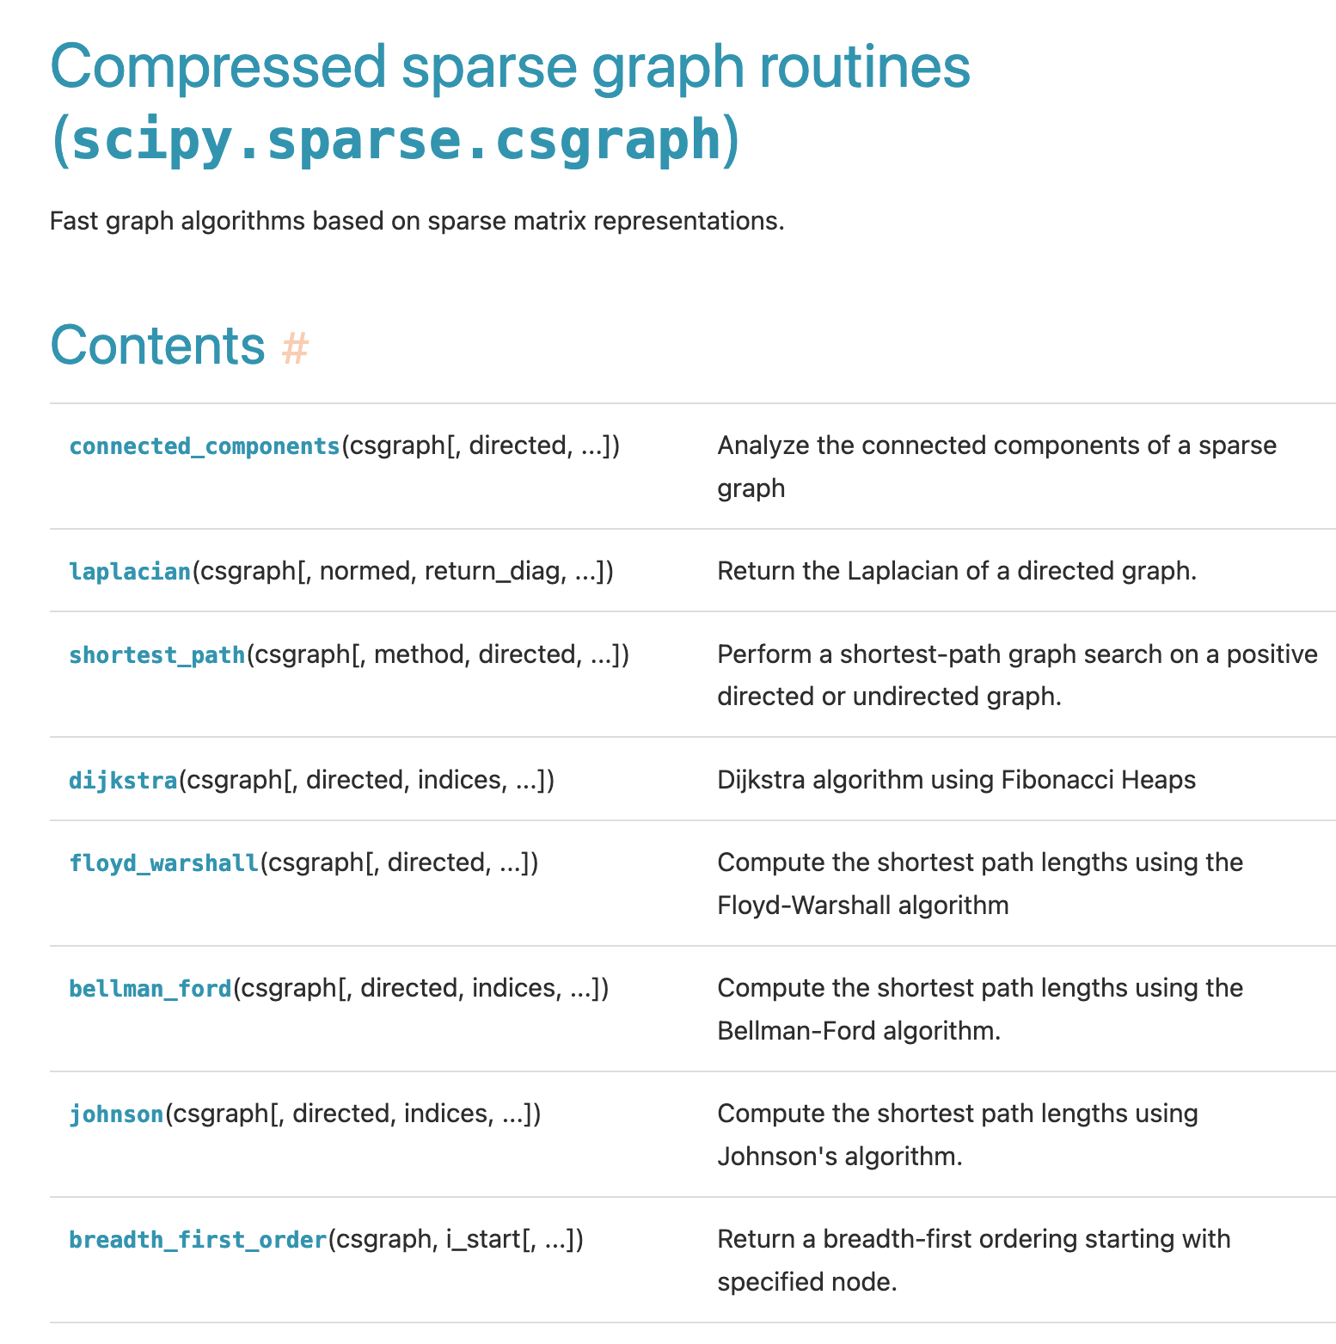
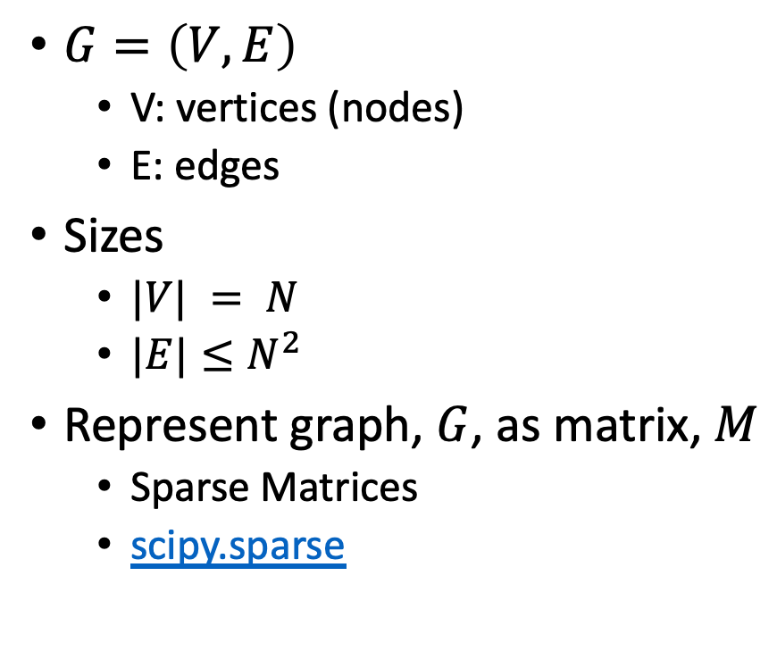
Graphs
$G=\left(V,E\right)$
V: vertices (nodes)
E: edges
Sizes
$|V| = N$
$|E|≤N^{2}$
Represent graph, $G$, as matrix, $M$
Sparse Matrices
scipy.sparse

Slide 4
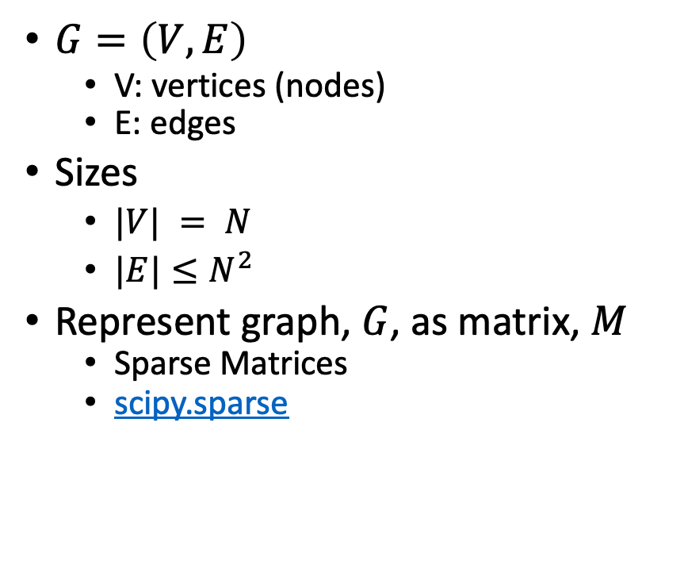
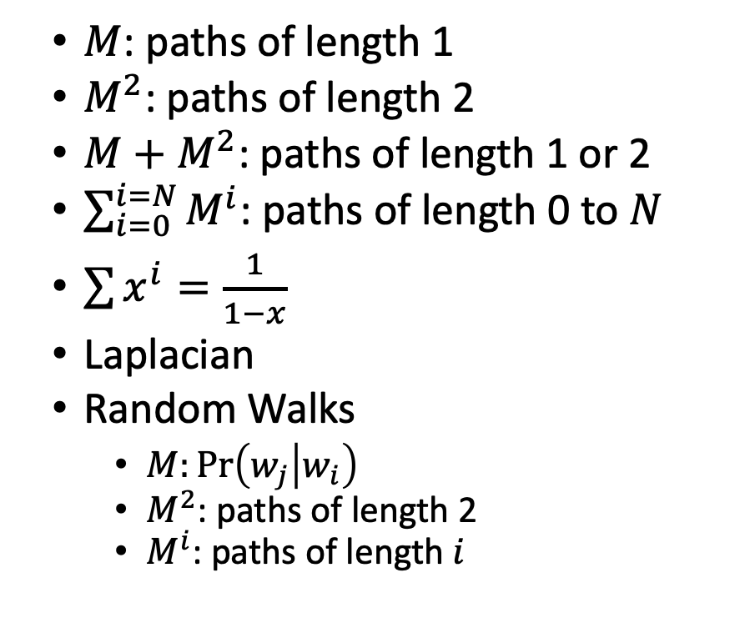
Graphs, Transitive Closure & Random Walks
$G=\left(V,E\right)$
V: vertices (nodes)
E: edges
Sizes
$|V| = N$
$|E|≤N^{2}$
Represent graph, $G$, as matrix, $M$
Sparse Matrices
scipy.sparse
$M$: paths of length 1
$M^{2}$: paths of length 2
$M+$ $M^{2}$: paths of length 1 or 2
$\sum_{i=0}^{i=N}{M^{i}}$: paths of length 0 to $N$
$\sum{x^{i}=\frac{1}{1−x}}$
Laplacian
Random Walks
$M:\operatorname{Pr}\left(w_{j} | w_{i}\right)$
$M^{2}$: paths of length 2
$M^{i}$: paths of length $i$

Slide 5
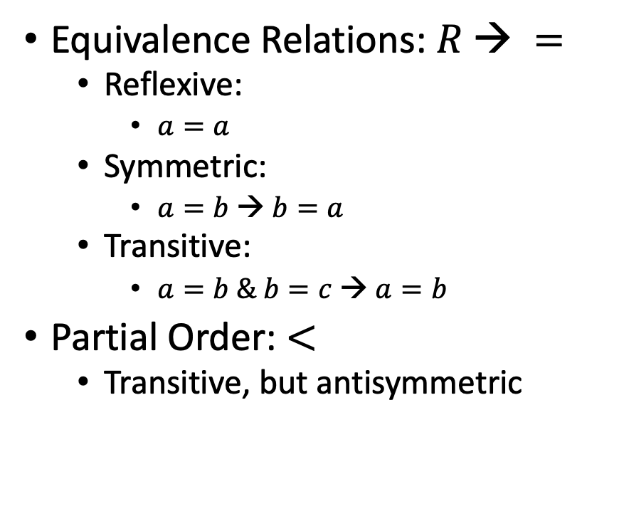

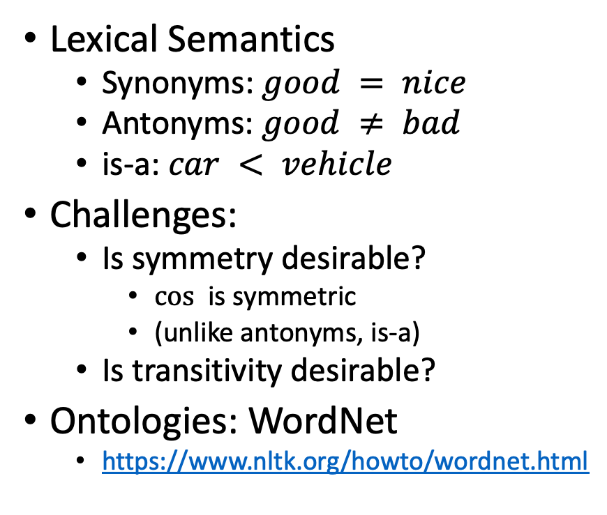
Relations: $R∈ \{=, ≠, <\}$
Equivalence Relations: $R → =$
Reflexive:
$a=a$
Symmetric:
$a=b → b=a$
Transitive:
$a=b \& b=c → a=b$
Partial Order: $<$
Transitive, but antisymmetric
Lexical Semantics
Synonyms: $good = nice$
Antonyms: $good ≠ bad$
is-a: $car < vehicle$
Challenges:
Is symmetry desirable?
$cos⁡$ is symmetric
(unlike antonyms, is-a)
Is transitivity desirable?
Ontologies: WordNet
https://www.nltk.org/howto/wordnet.html

Slide 6
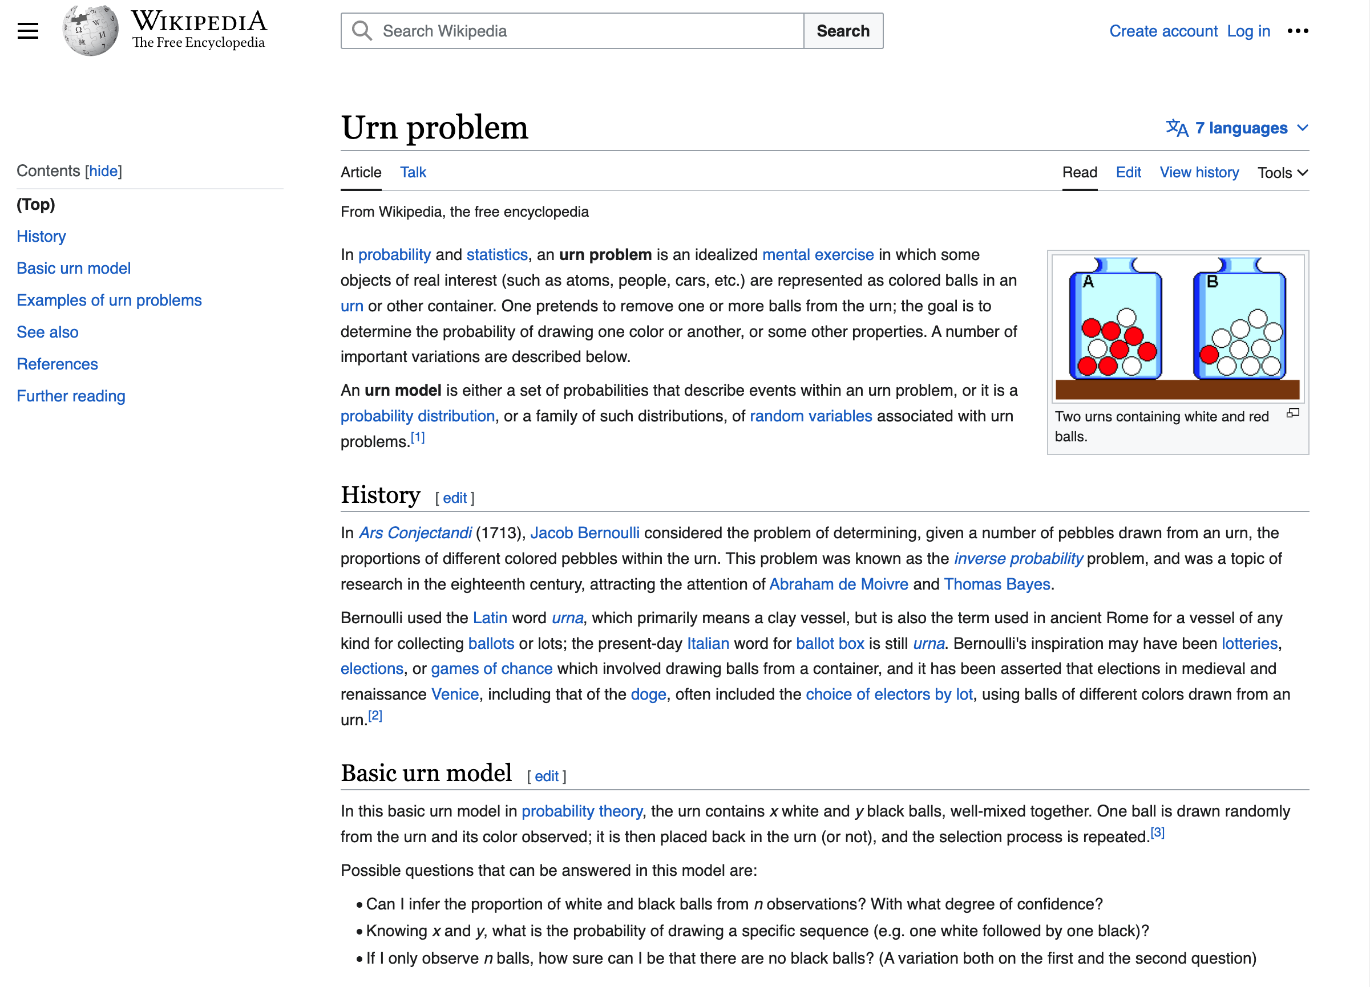
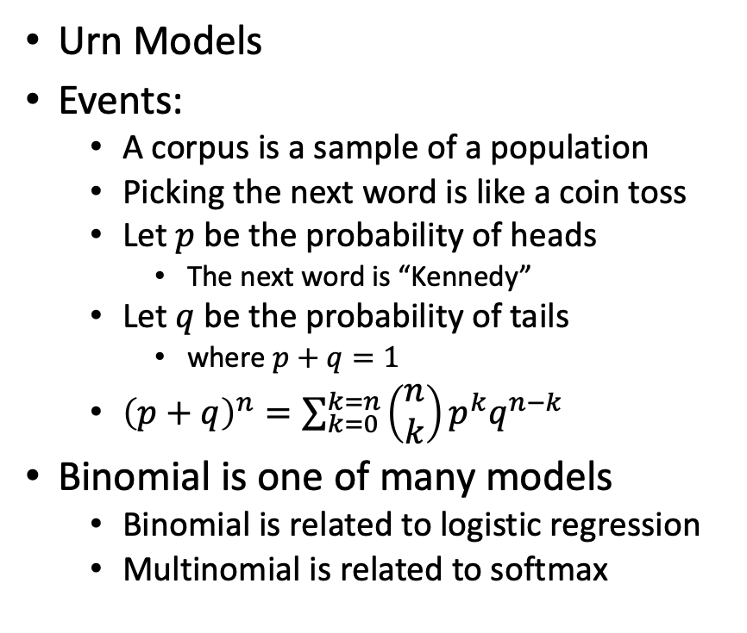
Probability Theory
Urn Models
Events:
A corpus is a sample of a population
Picking the next word is like a coin toss
Let $p$ be the probability of heads
The next word is “Kennedy”
Let $q$ be the probability of tails
where $p+q=1$
${\left(p+q\right)}^{n}=\sum_{k=0}^{k=n}{\left(\begin{matrix}n \\ k\end{matrix}\right)}p^{k}q^{n−k}$
Binomial is one of many models
Binomial is related to logistic regression
Multinomial is related to softmax

Slide 7
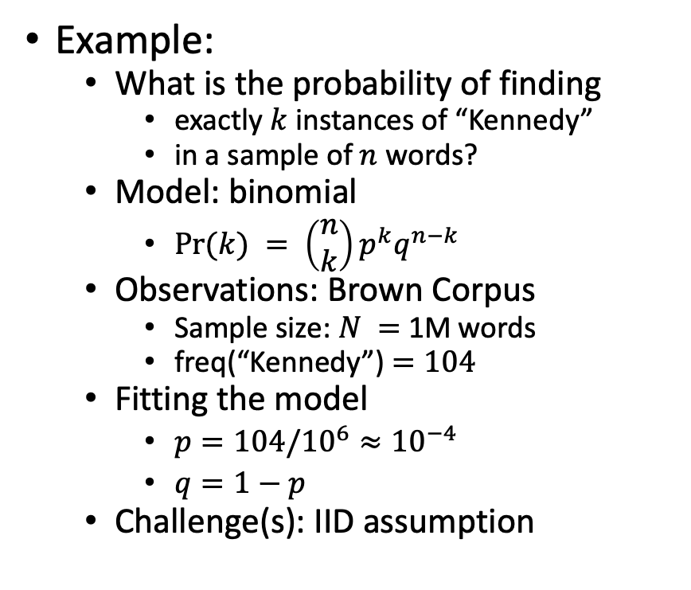
Statistics: Combining models with observations
Models (from Probability)
Binomial
Multinomial
Normal
Poisson
Exponential
Observations
Corpora
Data tables
Assumptions:
IID: https://en.wikipedia.org/wiki/Independent_and_identically_distributed_random_variables
Example:
What is the probability of finding
exactly $k$ instances of “Kennedy”
in a sample of $n$ words?
Model: binomial
$Pr⁡(k) = \left(\begin{matrix}n \\ k\end{matrix}\right)p^{k}q^{n−k}$
Observations: Brown Corpus
Sample size: $N =$ 1M words
freq(“Kennedy”) $=104$
Fitting the model
$p=104/{10}^{6}≈{10}^{−4}$
$q=1−p$
Challenge(s): IID assumption

Slide 8
Interestingness Metrics: Deviations from Independence
Poisson (and other independence assumptions)
Not bad for meaningless random strings
Deviations from Poisson are clues for hidden variables
Meaning, content, genre, topic, author, etc.
Analogous to pointwise mutual information (Hanks)
Pr(doctor…nurse) >> Pr(doctor) Pr(nurse)

Slide 9
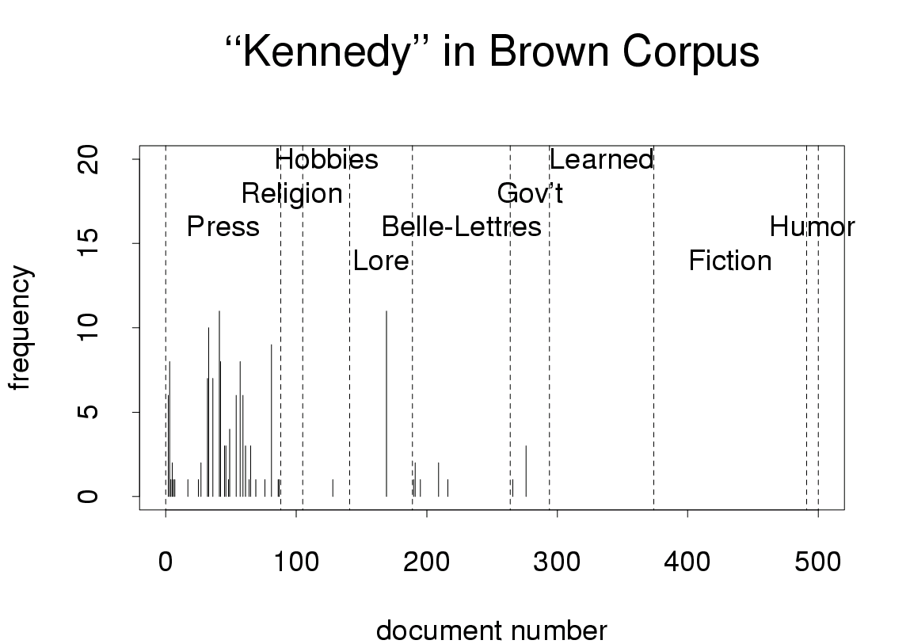

Slide 10
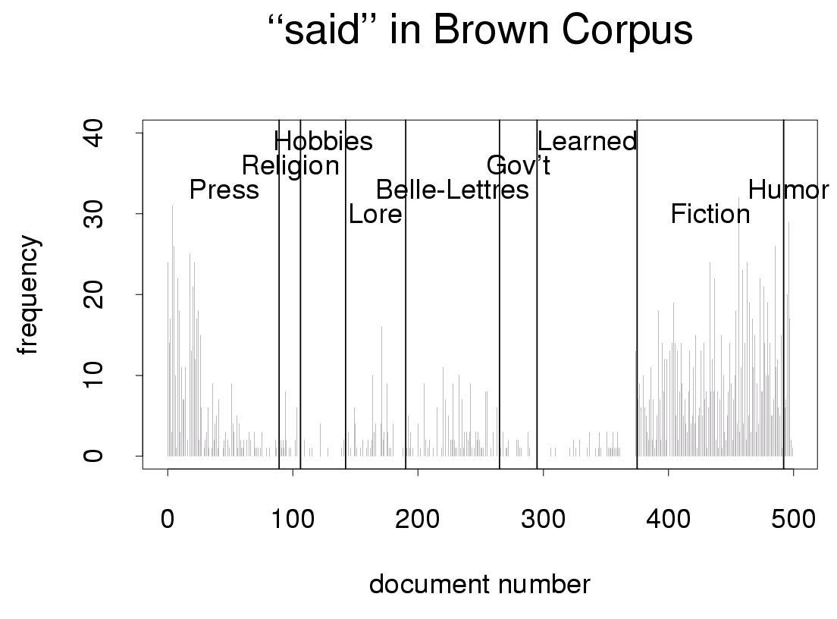

Slide 11
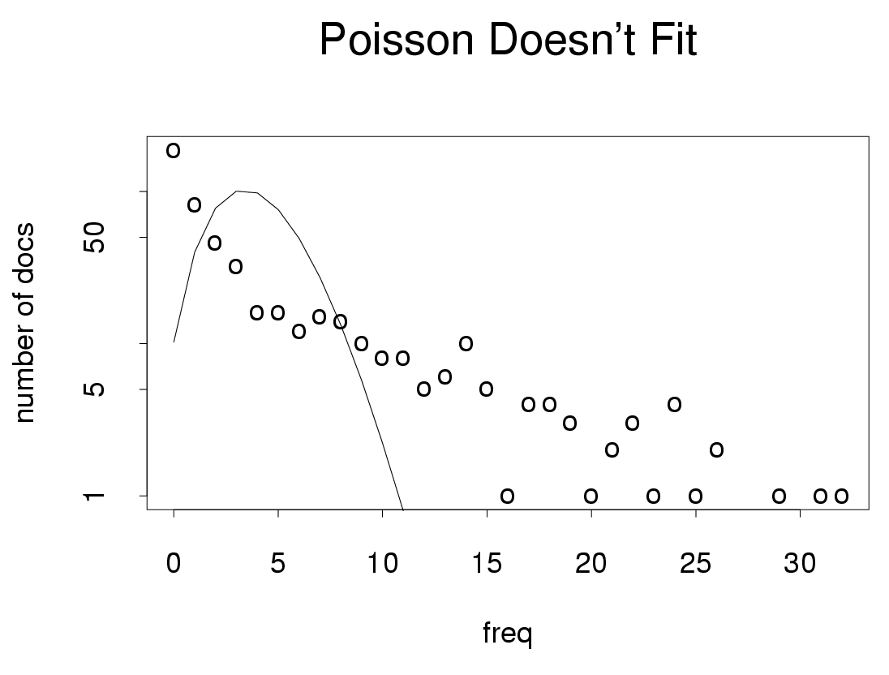

Slide 12
Adaptation is Lexical
Lexical: adaptation is
Stronger for good keywords (Kennedy)
Than random strings, function words (except), etc.
Content ≠ low frequency
+adapt | prior | −adapt | source | word
0.27 | 0.012 | 0.0091 | AP90 | Kennedy
0.40 | 0.015 | 0.0084 | AP91 | Kennedy
0.32 | 0.014 | 0.0094 | AP93 | Kennedy
0.049 | 0.016 | 0.016 | AP90 | except
0.048 | 0.014 | 0.014 | AP91 | except
0.048 | 0.012 | 0.012 | AP93 | except

Slide 13
Adaptation Conclusions
Large magnitude (p/2 >> p²); big quantity discounts
Distinctive shape
1st mention depends on freq
2nd does not
Priming: between 1st mention and 2nd
Lexical:
Independence assumptions aren’t bad for meaningless random strings, function words, common first names, etc.
More adaptation for content words (good keywords, OOV)

Slide 14
Word Association Norms, Mutual Information and Lexicography

Slide 15
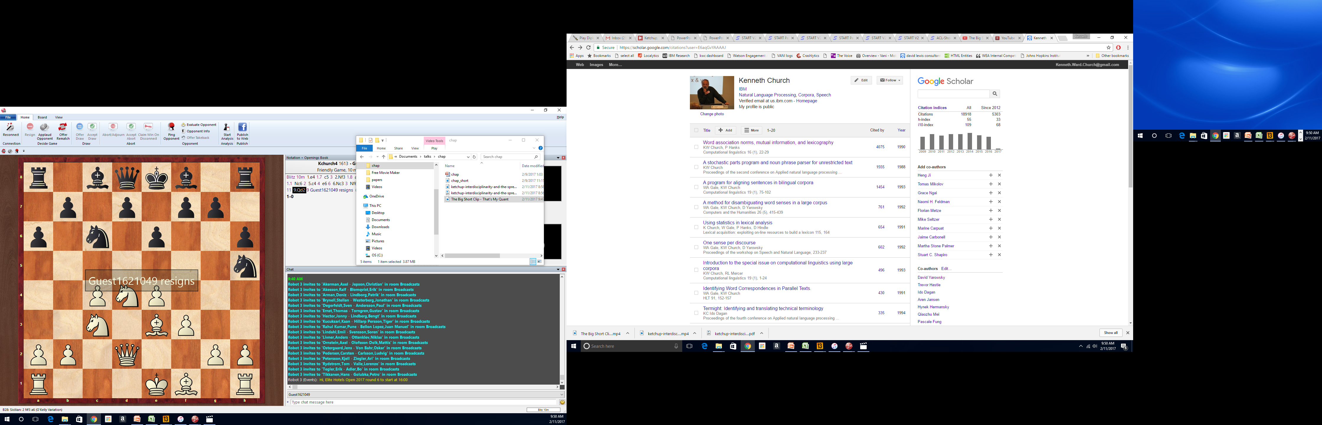
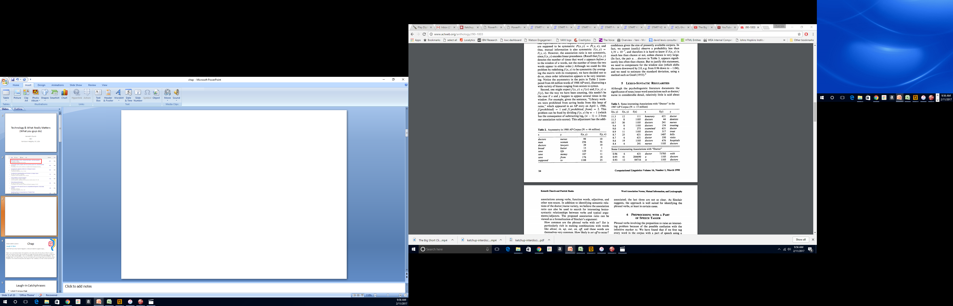
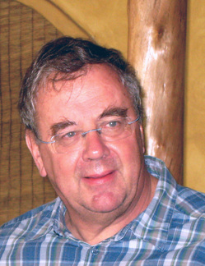

Slide 16
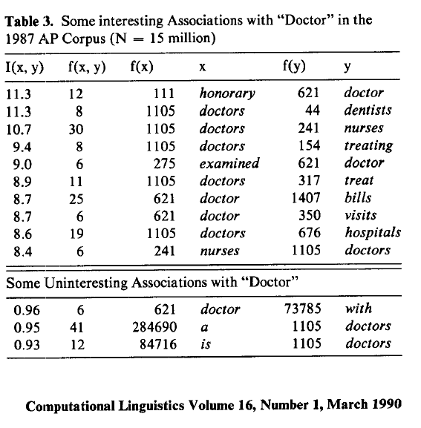
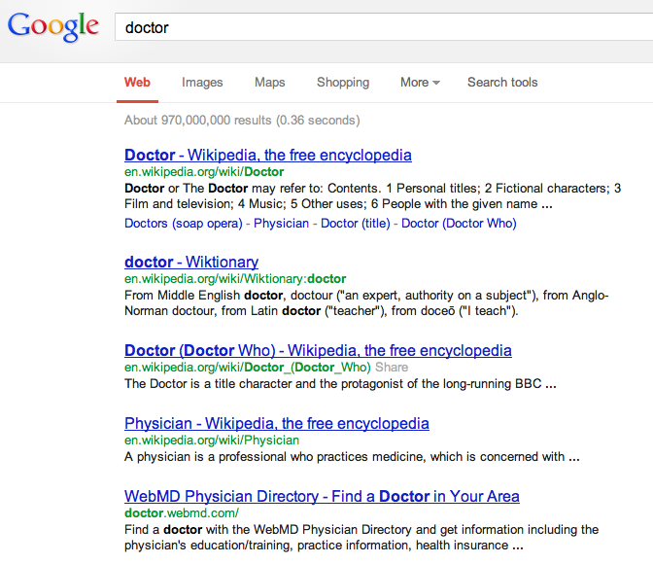
There is no data like more data
Counts are growing 1000x per decade
(same as disks)
Counts are growing 1000x per decade
(same as disks)
Rising Tide of Data Lifts All Boats

Slide 17
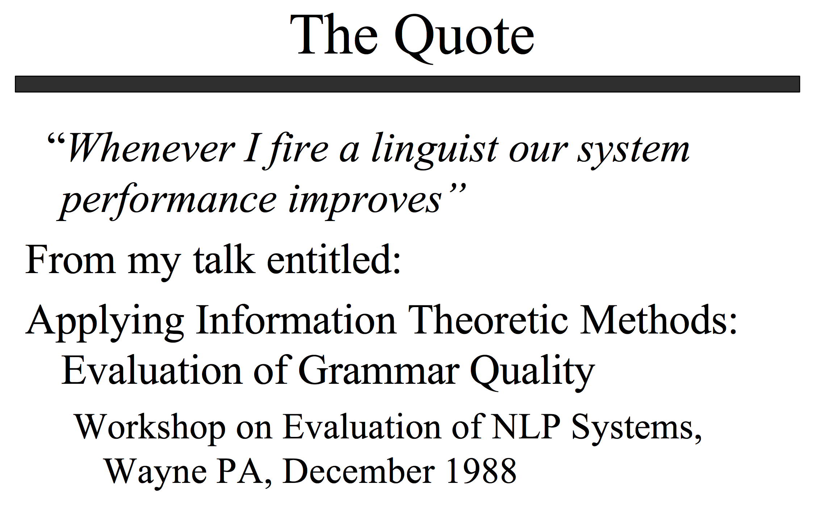
http://www.lrec-conf.org/lrec2004/doc/jelinek.pdf

Slide 18


Slide 19
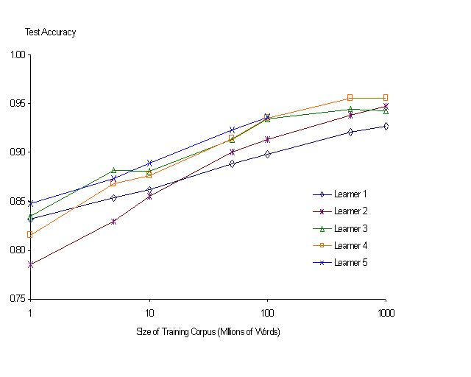
“It never pays to think until you’ve run out of data” – Eric Brill
Moore’s Law Constant:
Data Collection Rates → Improvement Rates
Banko & Brill: Mitigating the Paucity-of-Data Problem (HLT 2001)
No consistently
best learner
There is no data like more data
Quoted out of context
Fire everybody and
spend the money on data

Slide 20
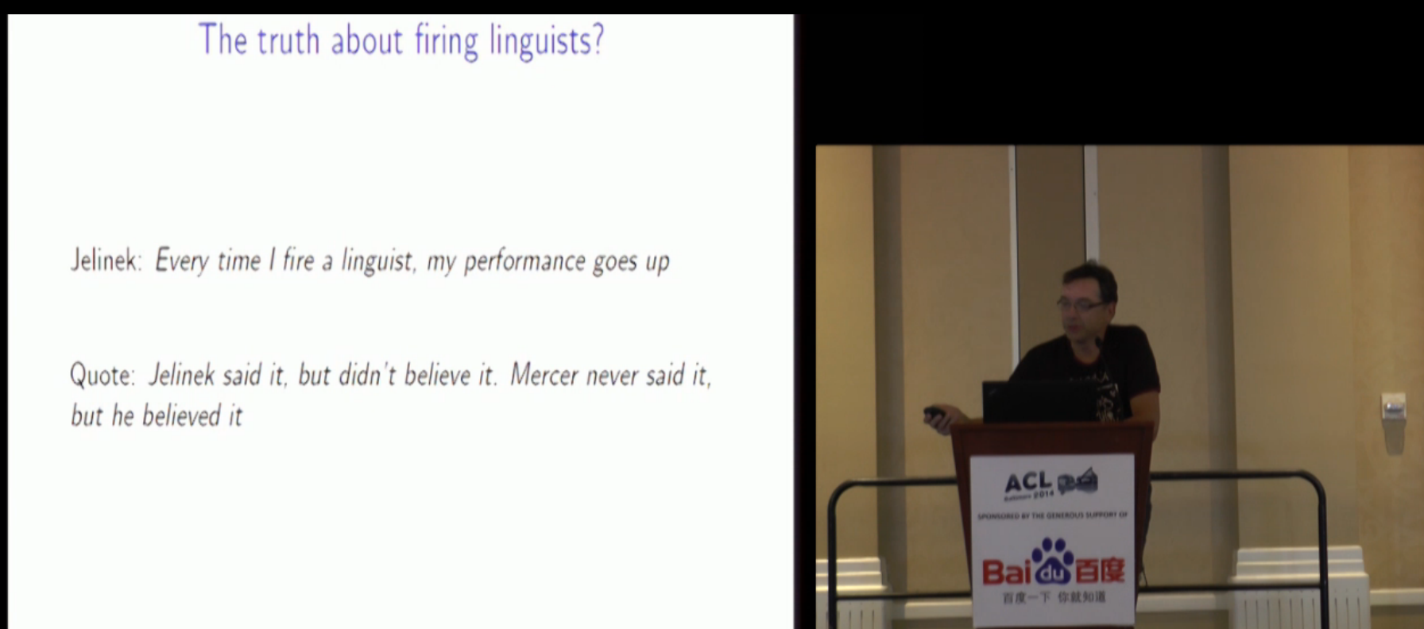
Robert Mercer ACL Lifetime Achievement http://techtalks.tv/talks/closing-session/60532/

Slide 21
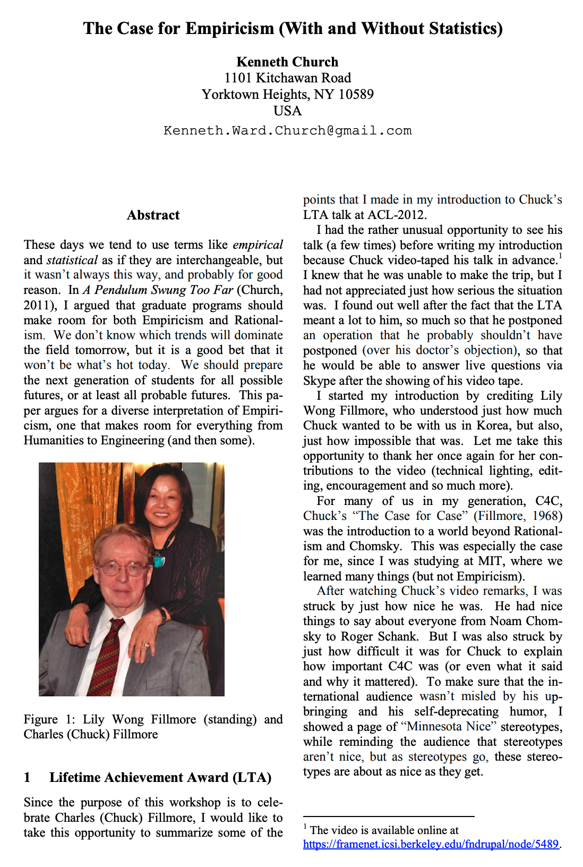
Computational Linguistics: Interdisciplinary Combination of Engineering and Humanities

Slide 22

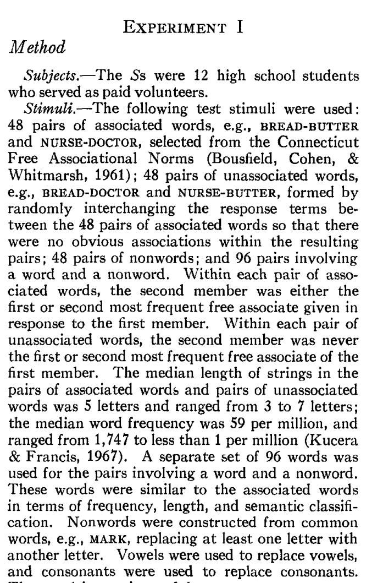
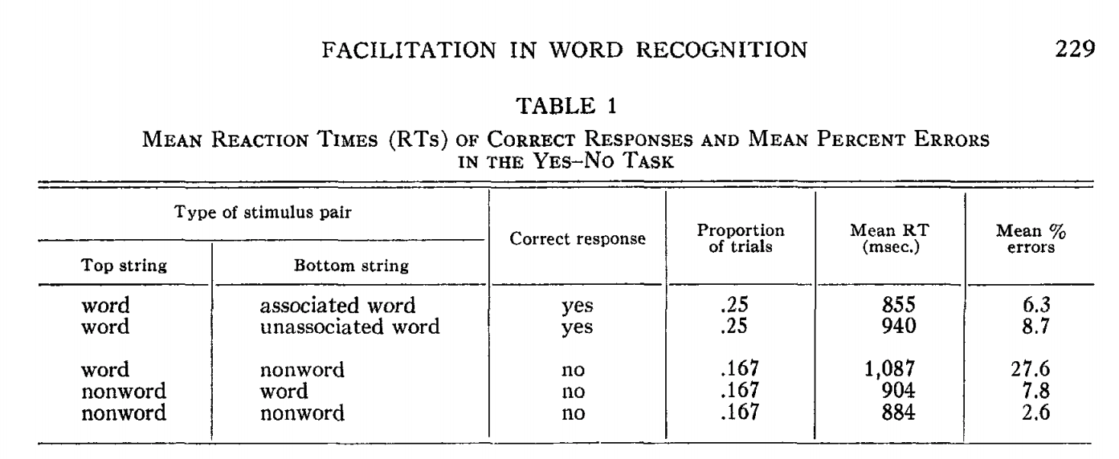
Priming & Word Associations Task: Subject is given two strings and responds “yes” if both are words

Slide 23
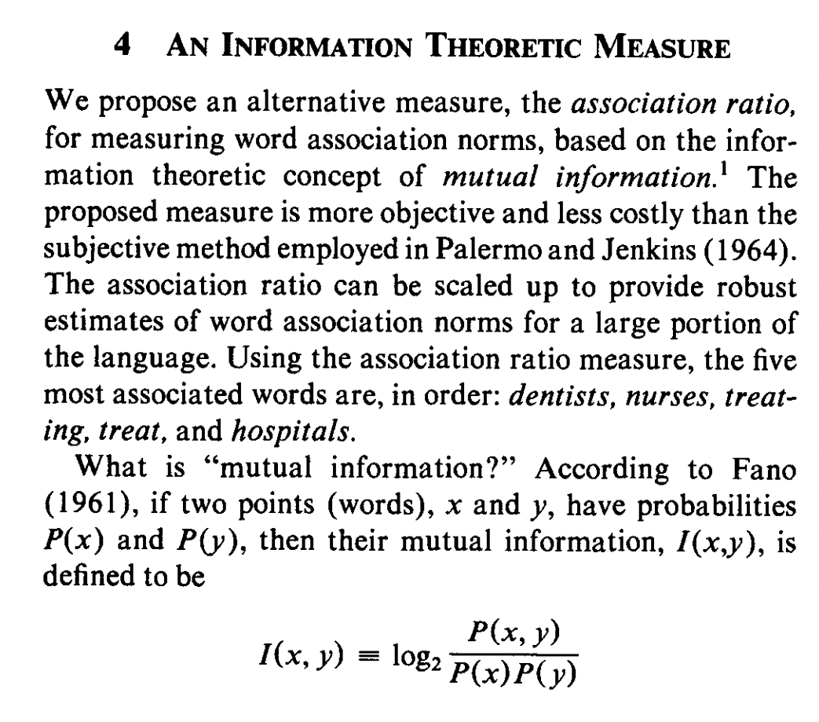
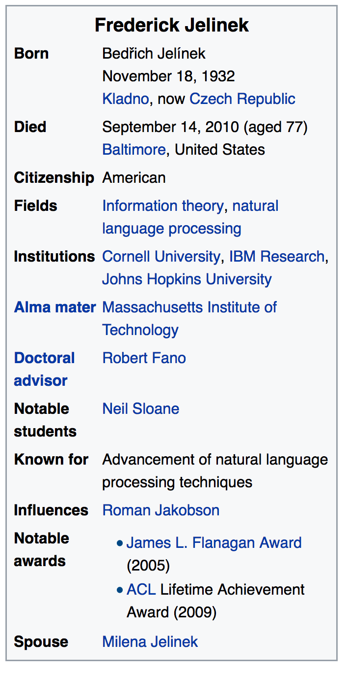
Pointwise Mutual Information (PMI)
Simple interpretation
PMI compares P(x,y) with chance
Chance = P(x) P(y)
If there is a genuine association
then P(x,y) >> P(x) P(y)
Uninteresting associations
P(x,y) ≈ P(x) P(y)
Popular applications (lexicography)
more like hypothesis testing
focus on largest PMI
where we can reject null hypothesis
null hypo: uninteresting
less like language modeling for speech and machine translation

Slide 24
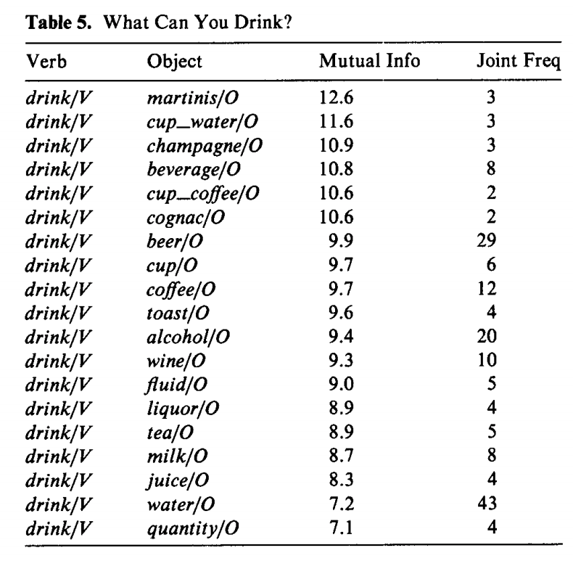
Windows for computing P(x,y)
Bigrams:
rectangular window with width of 1 word
Ngrams
rectangular window with width of n-1 words
More generally
Windows need not be rectangular
Or symmetric around 0
(Mutual Information is symmetric
but “Association Measure” is not)
Convenient to assume windows sum to 1
More interesting windows
Parse Trees / SVO

Slide 25
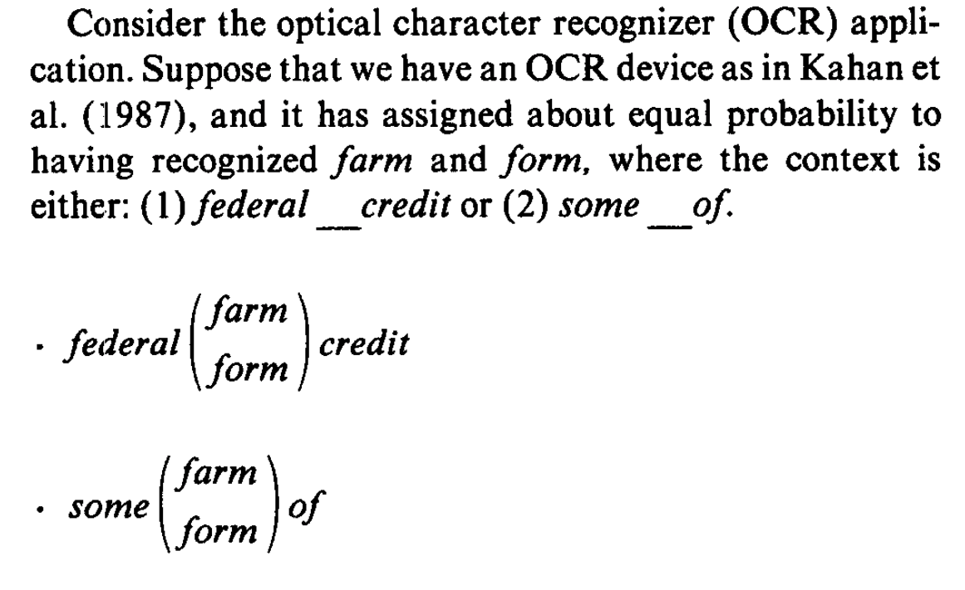
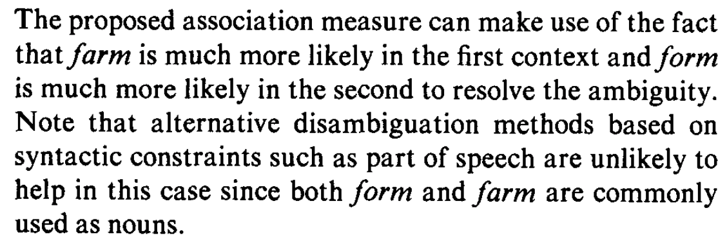
OCR Application

Slide 26
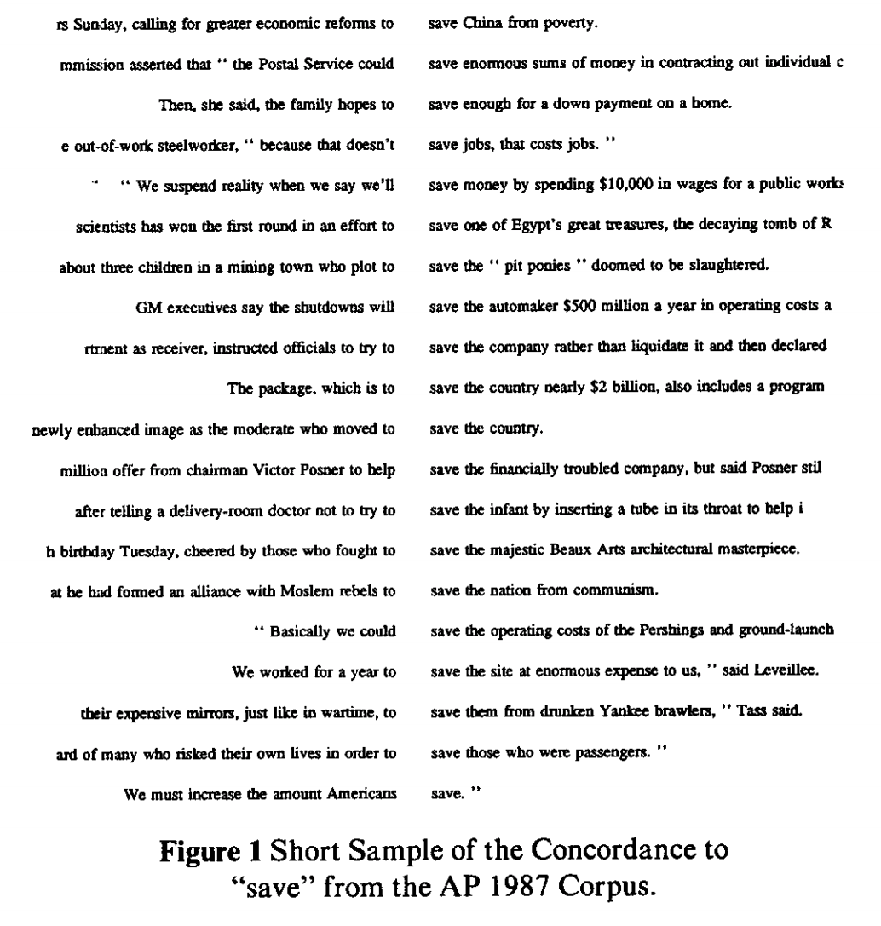
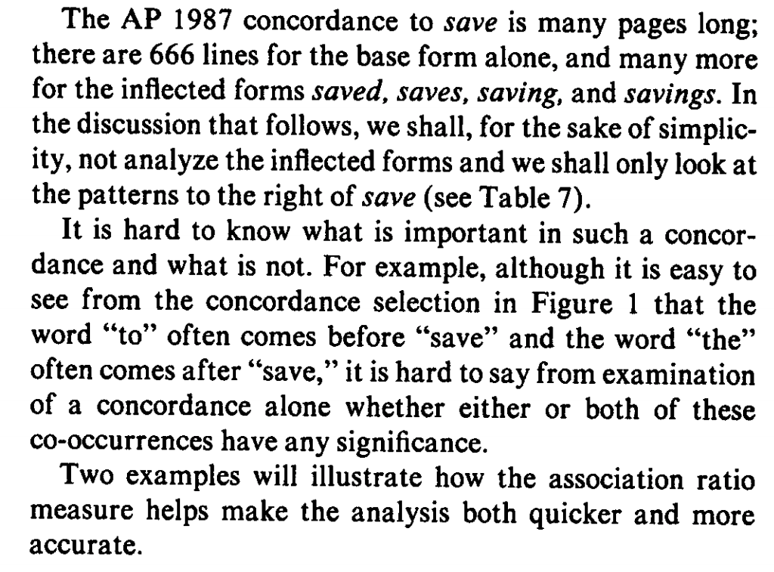
Applications in Lexicography

Slide 27
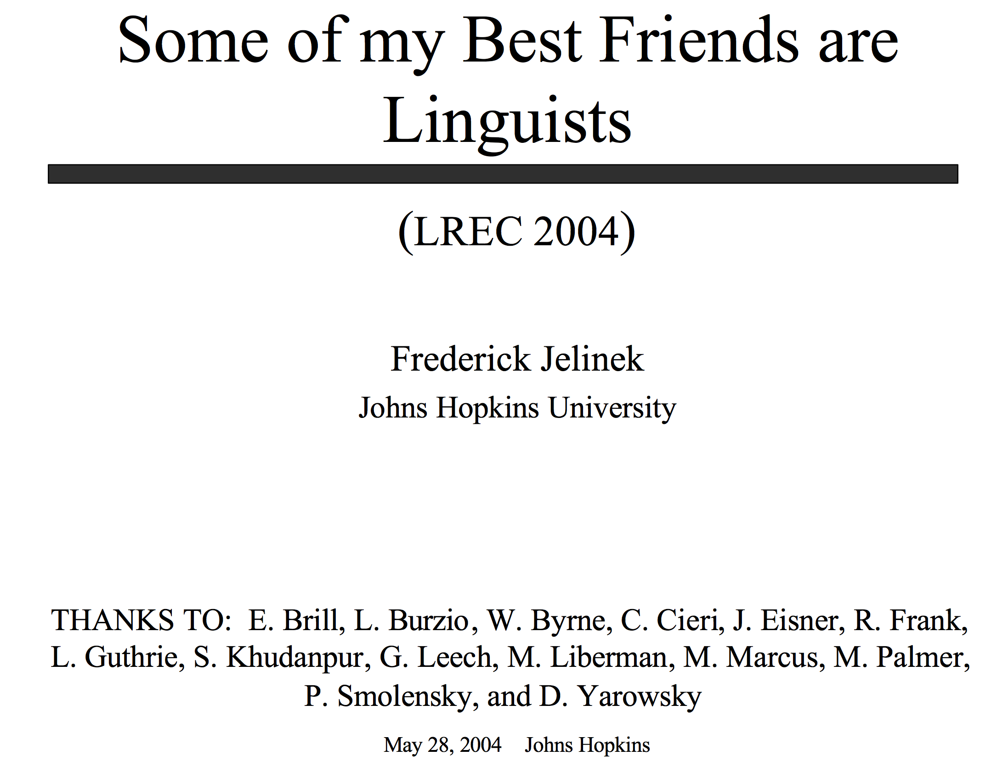
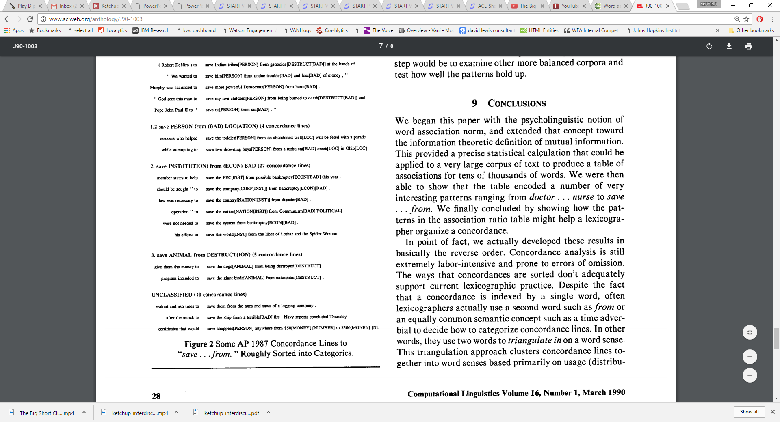
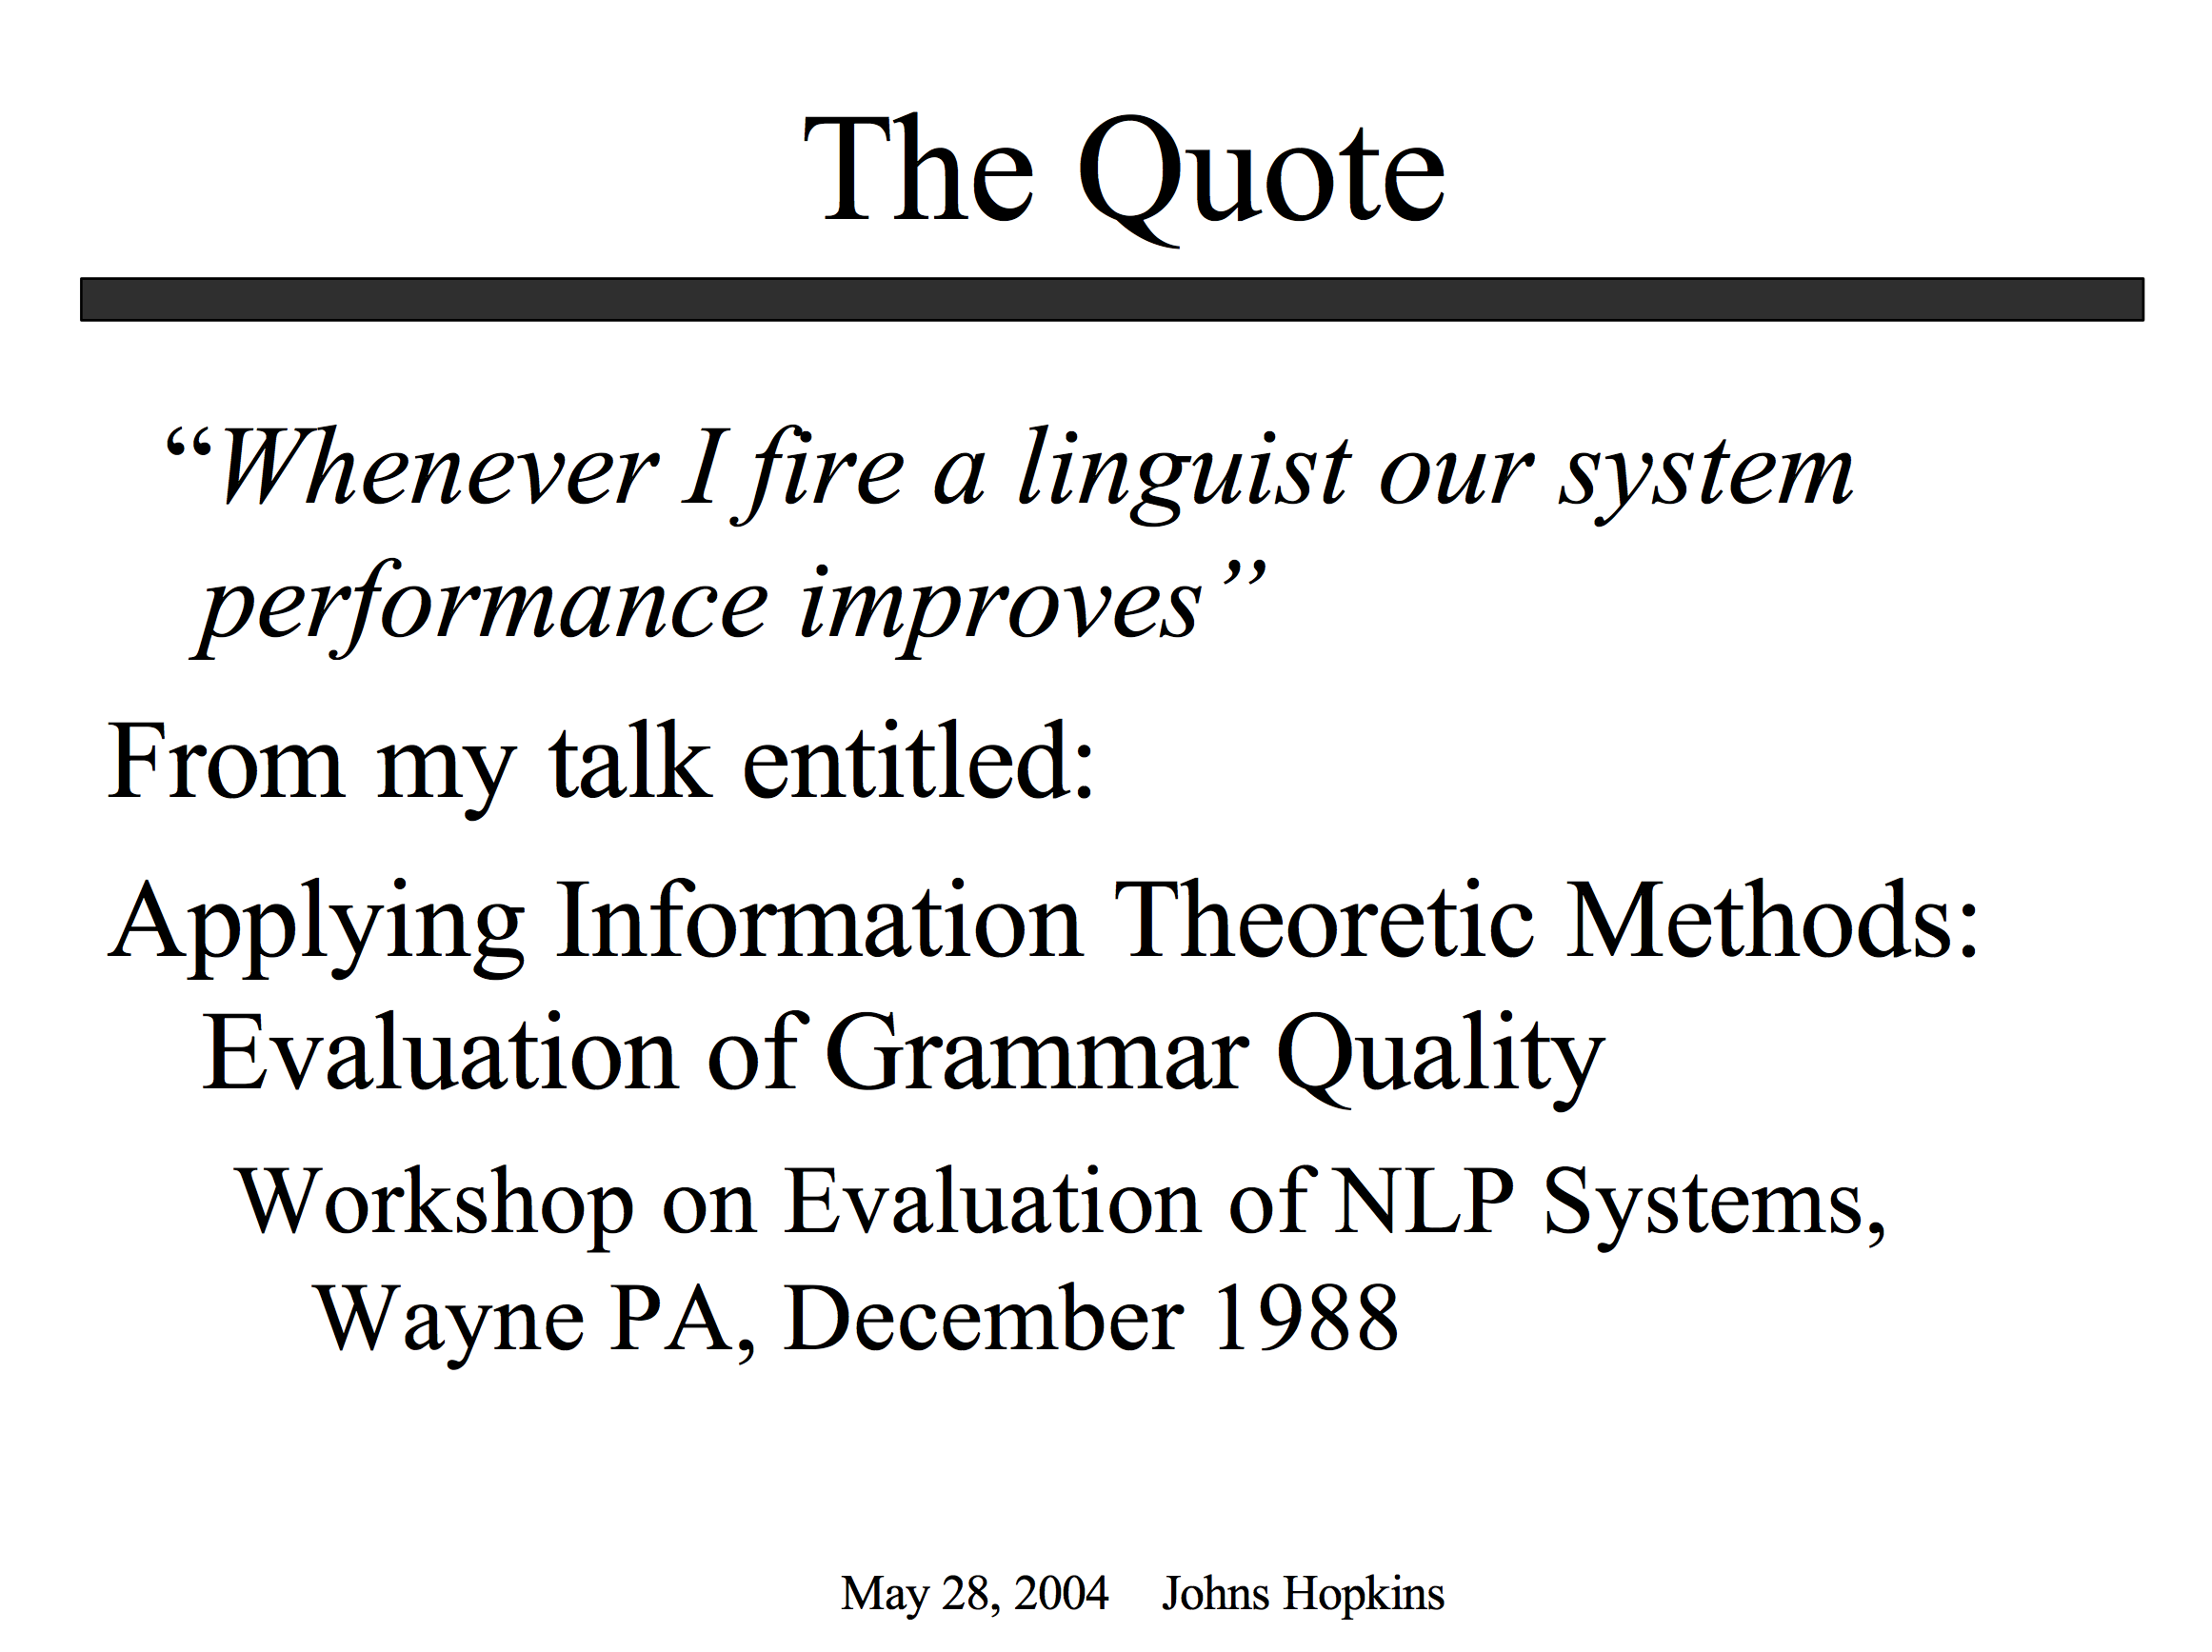
Proper Place for Automation: Start with Drudgery (Support our colleagues; don’t talk too much about taking away jobs they love to do)

Slide 28
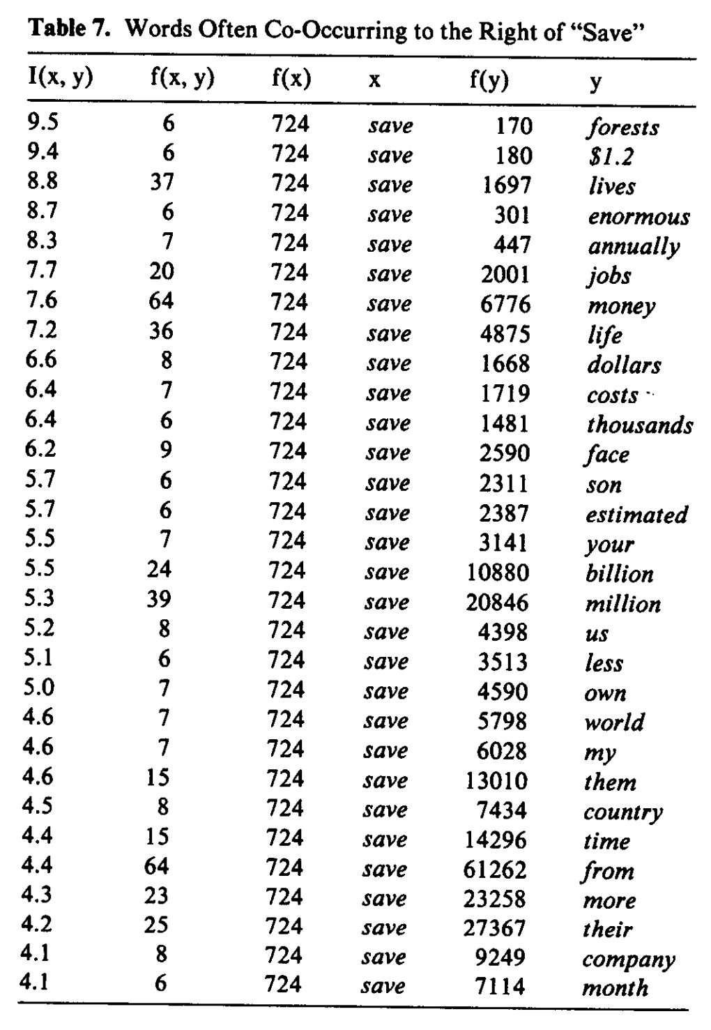
Patrick found tables like this very exciting

Slide 29
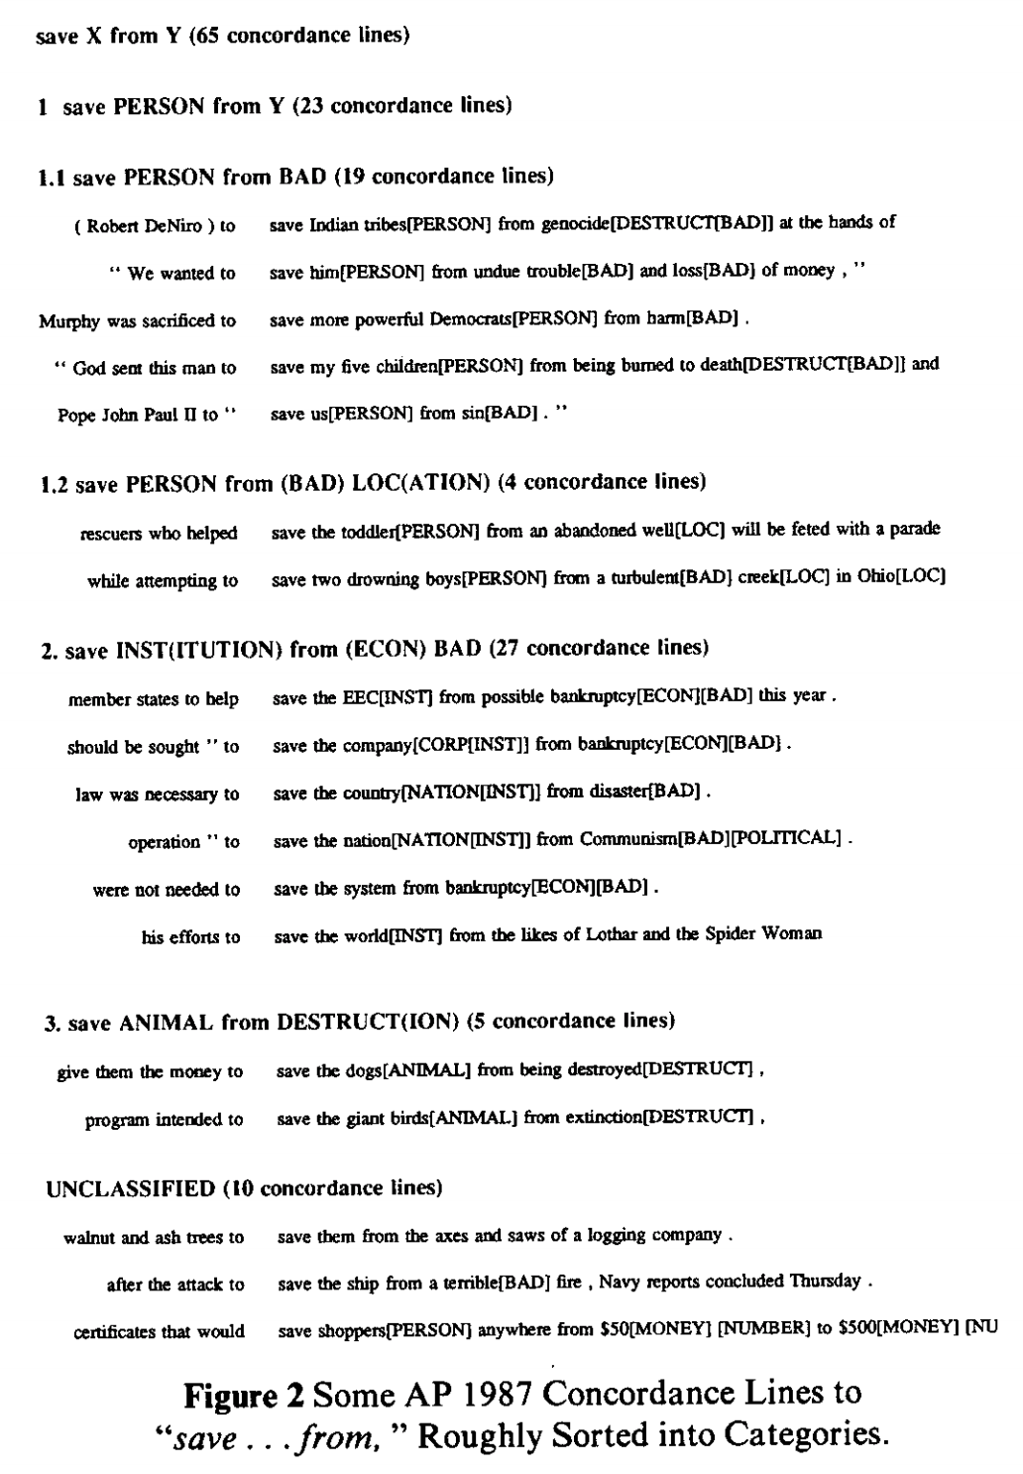
Save <good> from <bad>

Slide 30
Save good shoppers from their evil $$
Patrick wanted me to “fix” my bug

Slide 31
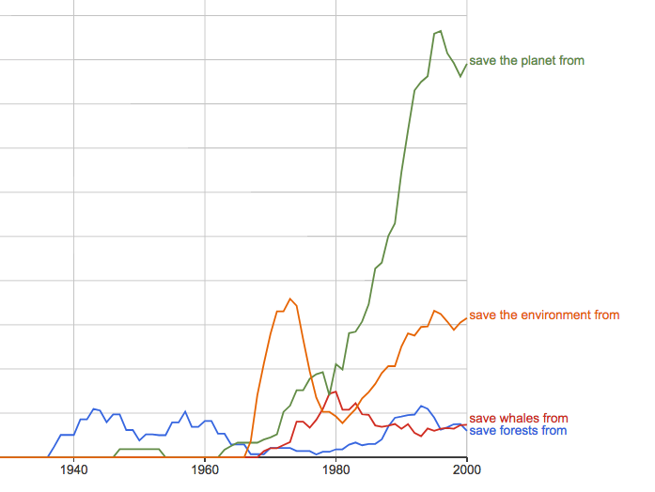
https://books.google.com/ngrams/graph?content=save+forests+from%2Csave+whales+from%2Csave+the+planet+from%2Csave+the+environment+from&year_start=1800&year_end=2000&corpus=15&smoothing=3&share=&direct_url=t1%3B%2Csave%20forests%20from%3B%2Cc0%3B.t1%3B%2Csave%20whales%20from%3B%2Cc0%3B.t1%3B%2Csave%20the%20planet%20from%3B%2Cc0%3B.t1%3B%2Csave%20the%20environment%20from%3B%2Cc0
Google Ngrams

Slide 32
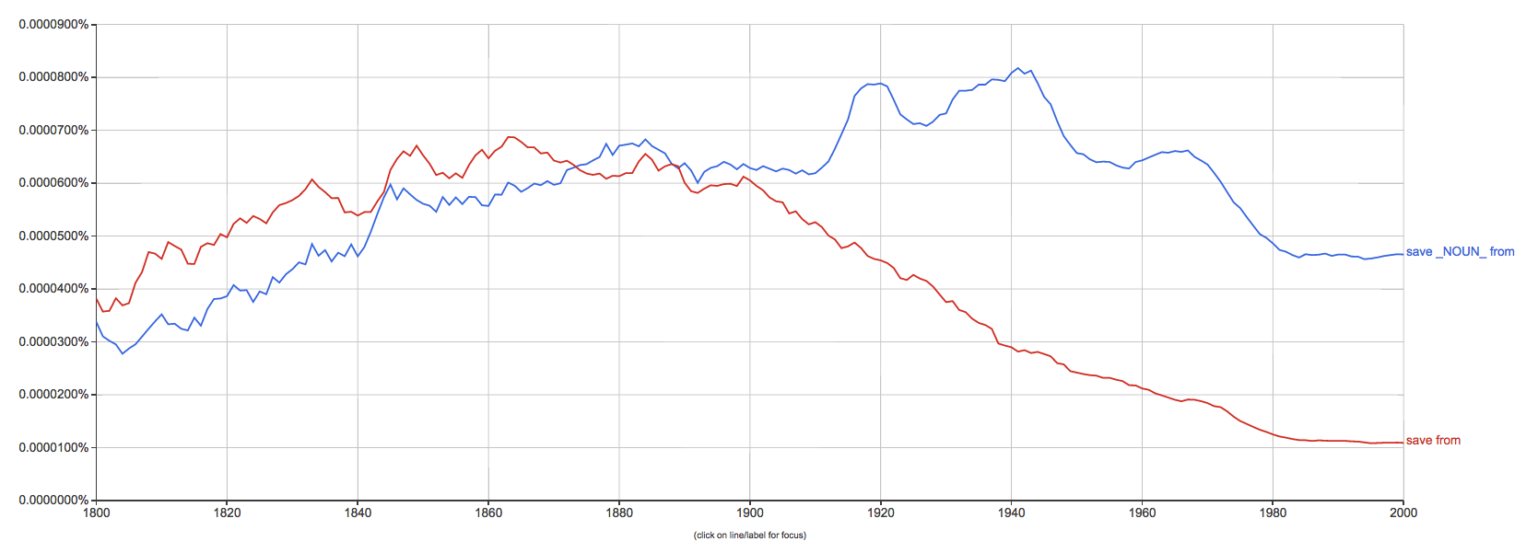
save from ≠ save X from Y

Slide 33
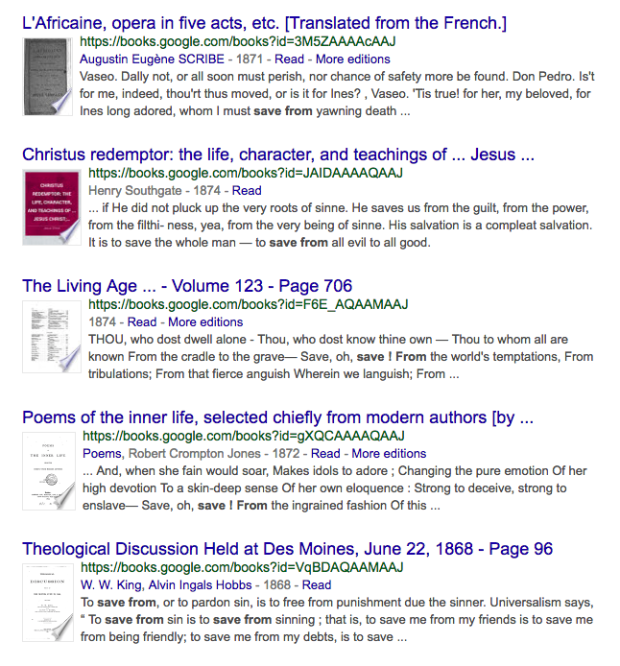
save from ≠ save X from Y

Slide 35
Agenda
Homework
Assignment 1: Better Together
Assignment 2: HuggingFace Pipelines
Background Material
Python
numpy, matplotlib, requests, json
sklearn, scipy
requests: APIs (Semantic Scholar)
Linear Algebra
Graph Algorithms
Probability
Machine Learning
Old Business
(Nearly) everything → Vector
Word2vec
Doc2vec
Similarity → Cosine
Approximate Nearest Neighbors
New Business
Colab
Deep Nets: Inference
Classification & Regression
Anything → Vector
Machine Translation
Fill Mask

Slide 36
Linear Algebra
Singular Value Decomposition (SVD)
Principal Component Analysis (PCA)
Dimension Reduction
Rotations
Approximate Nearest Neighbors (ANN)

Slide 37
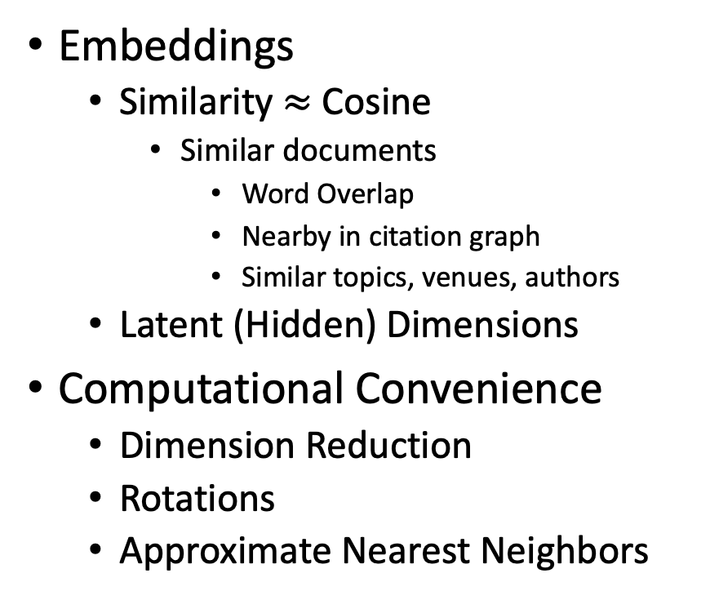
Nearly Everything To Vectors (Embeddings)
“Everything”
Words (Terms): word2vec
Documents (Text Strings):
doc2vec, BERT, Specter
Graphs (GNNs)
Example: citation graph
Semantics (“Meaning”)
All the world’s languages
Audio (Speech, Music)
Pictures and Videos
Embeddings
Similarity $≈$ Cosine
Similar documents
Word Overlap
Nearby in citation graph
Similar topics, venues, authors
Latent (Hidden) Dimensions
Computational Convenience
Dimension Reduction
Rotations
Approximate Nearest Neighbors

Slide 38

Salton’s Vector Space Model

Slide 39
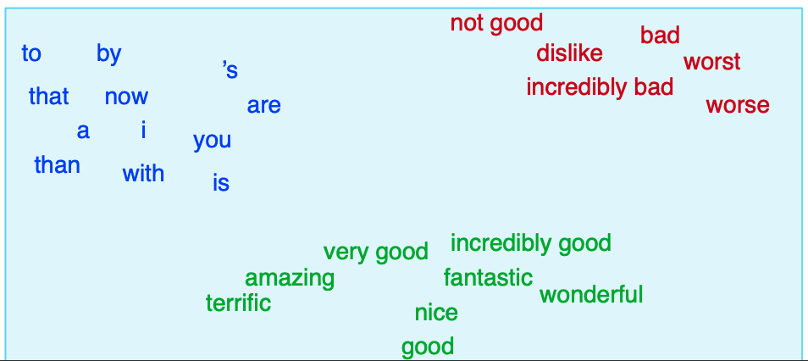
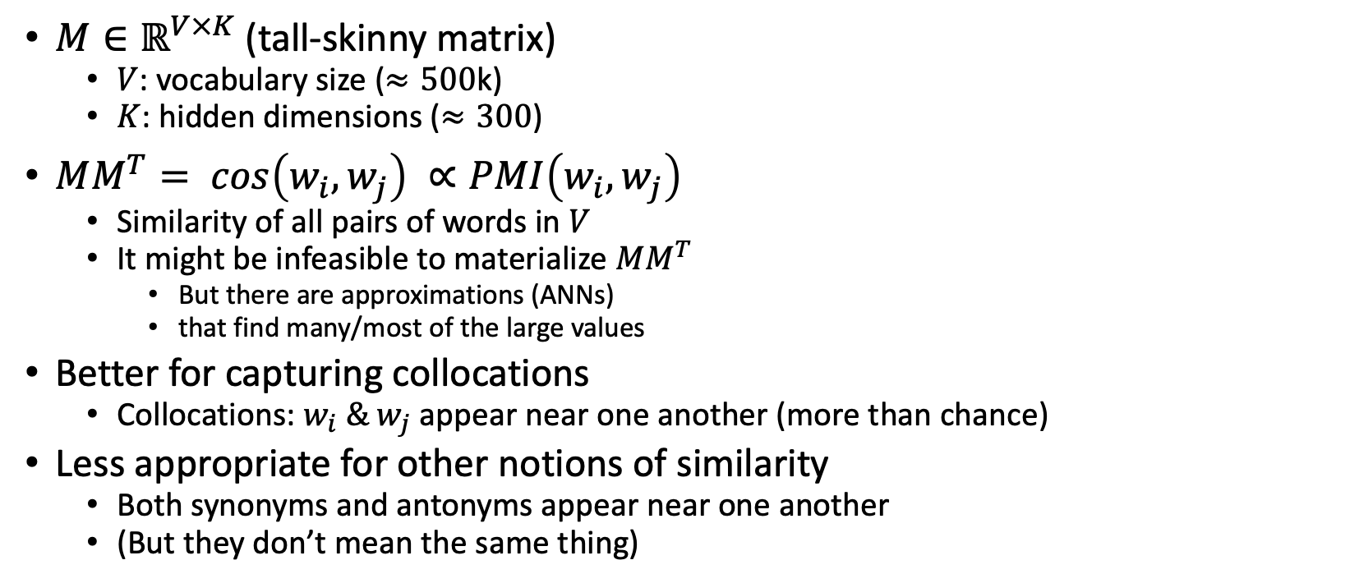
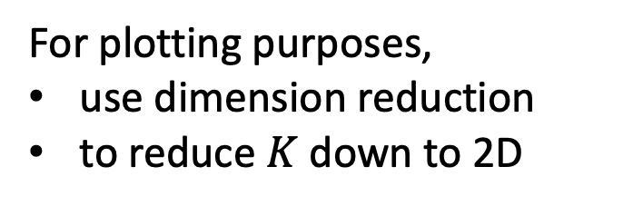
Word2vec (Embeddings)
$M∈ℝ^{V×K}$ (tall-skinny matrix)
$V$: vocabulary size ($≈500$k)
$K$: hidden dimensions ($≈300$)
$MM^{T}= cos\left(w_{i},w_{j}\right) ∝PMI\left(w_{i},w_{j}\right)$
Similarity of all pairs of words in $V$
It might be infeasible to materialize $MM^{T}$
But there are approximations (ANNs)
that find many/most of the large values
Better for capturing collocations
Collocations: $w_{i} \& w_{j}$ appear near one another (more than chance)
Less appropriate for other notions of similarity
Both synonyms and antonyms appear near one another
(But they don’t mean the same thing)
Slide from JM3
For plotting purposes,
use dimension reduction
to reduce $K$ down to 2D

Slide 40
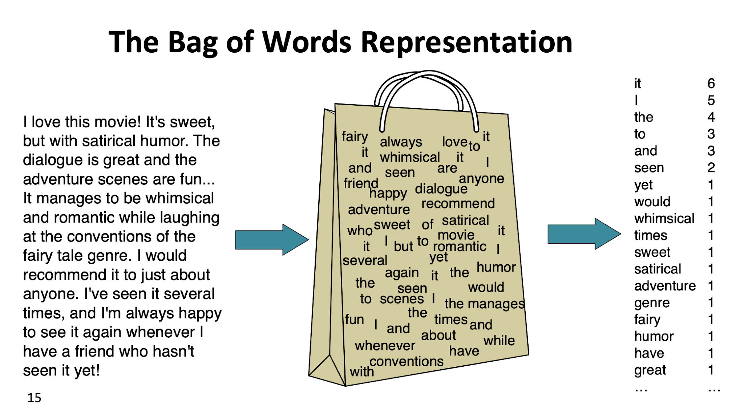
https://web.stanford.edu/~jurafsky/slp3/slides/7_NB.pdf

Slide 41
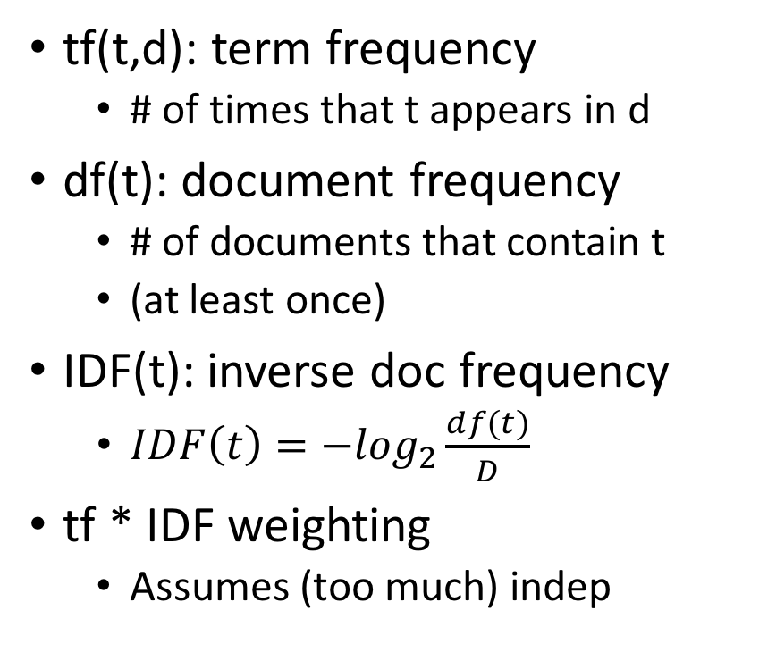
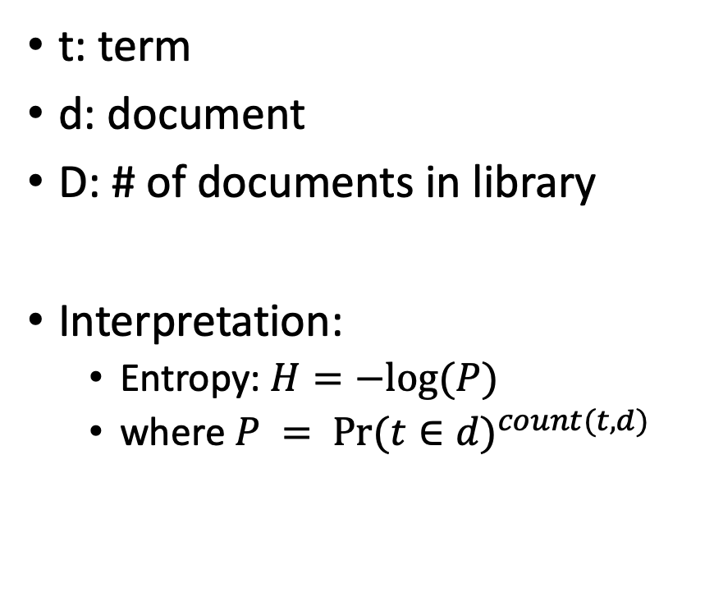
Information Retrieval (IR) notation Term Weighting: tf * IDF
t: term
d: document
D: # of documents in library
Interpretation:
Entropy: $H=−log⁡(P)$
where $P = {Pr⁡(t∈d)}^{count(t,d)}$
tf(t,d): term frequency
# of times that t appears in d
df(t): document frequency
# of documents that contain t
(at least once)
IDF(t): inverse doc frequency
$IDF\left(t\right)=−\log_{2}\frac{df(t)}{D}$
tf * IDF weighting
Assumes (too much) indep

Slide 42
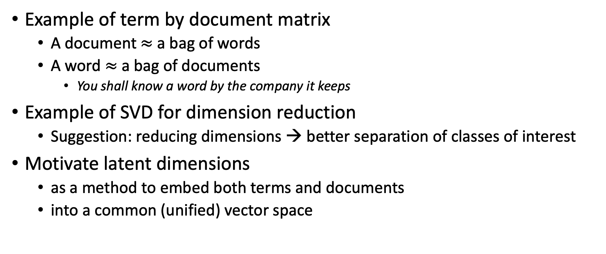
Bellcore Example
Example of term by document matrix
A document $≈$ a bag of words
A word $≈$ a bag of documents
You shall know a word by the company it keeps
Example of SVD for dimension reduction
Suggestion: reducing dimensions → better separation of classes of interest
Motivate latent dimensions
as a method to embed both terms and documents
into a common (unified) vector space

Slide 43
Bellcore’s Example: Bag of Words + SVD http://wordvec.colorado.edu/papers/Deerwester_1990.pdf
c1 Human machine interface for Lab ABC computer applications
c2 A survey of user opinion of computer system response time
c3 The EPS user interface management system
c4 System and human system engineering testing of EPS
c5 Relation of user-perceived response time to error measurement
m1 The generation of random, binary, unordered trees
m2 The intersection graph of paths in trees
m3 Graph minors IV: Widths of trees and well-quasi-ordering
m4 Graph minors: A survey

Slide 44
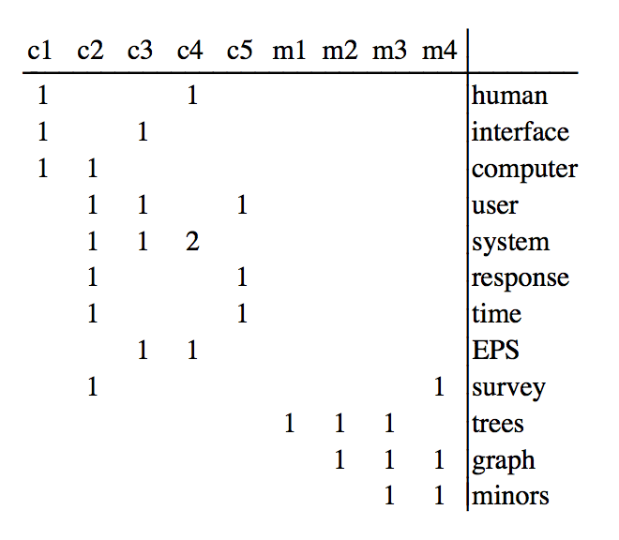
Term by Documents Matrix
c1 | Human machine interface for Lab ABC computer applications
c2 | A survey of user opinion of computer system response time
c3 | The EPS user interface management system
c4 | System and human system engineering testing of EPS
c5 | Relation of user-perceived response time to error measurement
m1 | The generation of random, binary, unordered trees
m2 | The intersection graph of paths in trees
m3 | Graph minors IV: Widths of trees and well-quasi-ordering
m4 | Graph minors: A survey

Slide 45
Term by Document Matrix

Slide 46
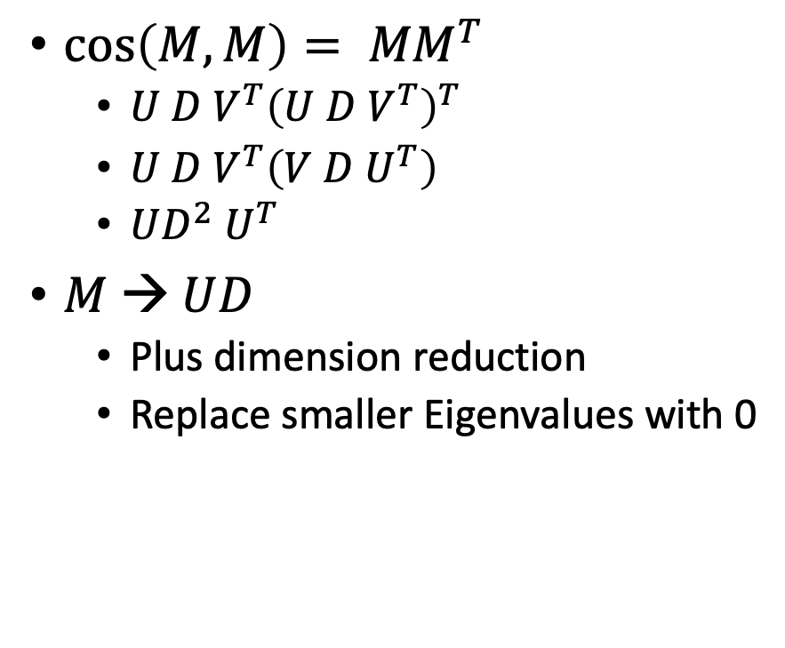
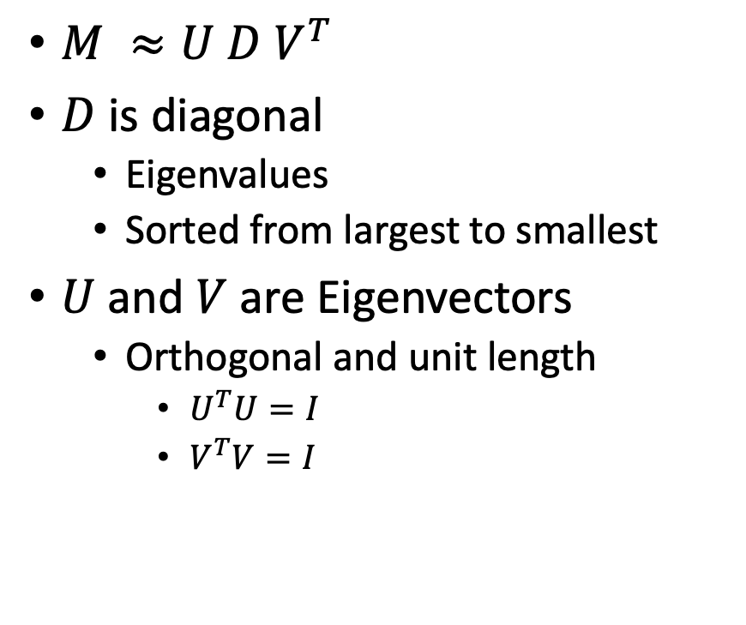
Singular Value Decomposition (SVD)
$M ≈U D V^{T}$
$D$ is diagonal
Eigenvalues
Sorted from largest to smallest
$U$ and $V$ are Eigenvectors
Orthogonal and unit length
$U^{T}U=I$
$V^{T}V=I$
$\cos\left(M,M\right)= {MM}^{T}$
$U D V^{T}{\left(U D V^{T}\right)}^{T}$
$U D V^{T}{\left(V D U^{T}\right)}^{}$
$UD^{2}$ $U^{T}$
$M → UD$
Plus dimension reduction
Replace smaller Eigenvalues with 0

Slide 47
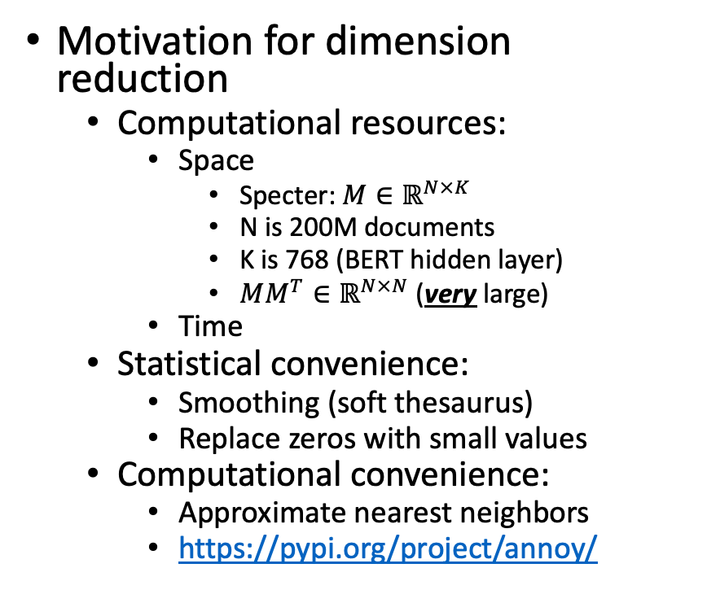
Dimension Reduction
Standard Recipe
Set smaller Eigenvalues to 0
Interpretation
L2 optimality (least squares)
Recall that Eigenvalues are sorted from largest to smallest
Motivation for dimension reduction
Computational resources:
Space
Specter:$M∈ℝ^{N×K}$
N is 200M documents
K is 768 (BERT hidden layer)
$MM^{T}∈ℝ^{N×N}$ (very large)
Time
Statistical convenience:
Smoothing (soft thesaurus)
Replace zeros with small values
Computational convenience:
Approximate nearest neighbors
https://pypi.org/project/annoy/

Slide 48


SVD and PCA
SVD (Singular Value Decomposition)
PCA (Principal Componenet Analysis)
$M ≈U D V^{T}$
$D$: Eigenvalues
$U$: Eigenvectors
$M$ need not be square
(just non-singular)
$Q∝ X^{T}X=WΛW^{T}$
$Q$ is square by construction
$Λ$: Eigenvalues
$W$: Covariances
Diagonal of $W$ are variances

Slide 49

Dimension Reduction in R $$bellcore ≈U D V^{T}$$
bellcore =
structure(.Data = c(1, 1, 1, 0, 0, 0, 0, 0, 0, 0, 0, 0, 0, 0, 1, 1, 1, 1, 1, 0, 1, 0, 0, 0, 0, 1, 0, 1, 1, 0, 0, 1, 0, 0, 0, 0, 1, 0, 0, 0, 2, 0, 0, 1, 0, 0, 0, 0, 0, 0, 0, 1, 0, 1, 1, 0, 0, 0, 0, 0, 0, 0, 0, 0, 0, 0, 0, 0, 0, 1, 0, 0, 0, 0, 0, 0, 0, 0, 0, 0, 0, 1, 1, 0, 0, 0, 0, 0, 0, 0, 0, 0, 0, 1, 1, 1, 0, 0, 0, 0, 0, 0, 0, 0, 1, 0, 1, 1),
.Dim = c(12, 9),
.Dimnames = list(c("human", "interface", "computer", "user", "system", "response", "time", "EPS", "survey", "trees", "graph", "minors"),
c("c1", "c2", "c3", "c4", "c5", "m1", "m2", "m3", "m4")))
b = svd(bellcore)
b2 = b$u[,1:2] %*% diag(b$d[1:2]) %*% t(b$v[,1:2])
dimnames(b2) = dimnames(bellcore)
par(mfrow=c(2,2))
plot(hclust(as.dist(-cor(bellcore))))
plot(hclust(as.dist(-cor(t(bellcore)))))
plot(hclust(as.dist(-cor(b2))))
plot(hclust(as.dist(-cor(t(b2)))))

Slide 50


SVD maps terms & docs into internal dimensions

Slide 51

$$bellcore ≈U D V^{T}$$

Slide 52


b = svd(bellcore)
b2 = b$u[,1:2] %*% diag(b$d[1:2]) %*% t(b$v[,1:2])
dimnames(b2) = dimnames(bellcore)
par(mfrow=c(2,2))
plot(hclust(as.dist(-cor(bellcore))))
plot(hclust(as.dist(-cor(t(bellcore)))))
plot(hclust(as.dist(-cor(b2))))
plot(hclust(as.dist(-cor(t(b2)))))

Slide 53

Latent concept vector space
• term
document
query
--- cosine > 0.9

Slide 54



Approximate Nearest Neighbors (ANN)
Indexing time:
Input: Embedding $M∈ℝ^{N×K}$
Output: Indexes
Query time:
Input:
Embedding, Indexes, query
Query: $q∈ℝ^{K}$
Output: candidates, $c∈ℝ^{K}$
where $c$ is near $q$
sorted by $sim(q,c)$
https://radimrehurek.com/gensim/auto_examples/tutorials/run_annoy.html
https://pypi.org/project/annoy/

Slide 55
Formula for Survey Papers (Start thinking about your final project)
Summarize main points of paper
Call out
some highlights of subsequent literature
suggestions for future work

Slide 56

Shameless Plug https://www.semanticscholar.org/product/api/gallery

Slide 57

Using Google Scholar to find subsequent work to call out
Text Classification
LSA
Sentiment
Sentiment
Lexicography

Slide 58



Levy & Goldberg (NIPS-2014) Word2Vec ≈ PMI (Pointwise Mutual Info) $sim\left(x,y\right)=\cos\left(vec\left(x\right), vec\left(y\right)\right)≈PMI(x,y)$
What happened in 2014?

Slide 59
Word2vec is popular (massively cited)
Word2vec is not first, last or best to discuss
Vector spaces, embeddings, analogies, similarity metrics, etc.
But word2vec is simple and accessible
Anyone can download the code and use it in their next paper.
Any many do (for better and for worse)
Available downloads
Pre-computed vectors (no training required)
Code for training your own vectors on your own corpora

Slide 60
Word2vec is popular (massively cited)
Word2vec is not first, last or best to discuss
Vector spaces, embeddings, analogies, similarity metrics, etc.
But word2vec is simple and accessible
Anyone can download the code and use it in their next paper.
Any many do (for better and for worse)
Available downloads
Pre-computed vectors (no training required)
Code for training your own vectors on your own corpora

Slide 61


Word2Vec: $sim\left(x,y\right)=\cos\left(vec\left(x\right), vec\left(y\right)\right)≈PMI(x,y)$ https://code.google.com/archive/p/word2vec/
Linguistic generalizations
Word associations (distance in plot)
Features (red line)
Countries & Capitals
Analogies:
Man : Woman :: King : x
x → queen
Athens : Greece :: Bangkok: x
x → Thailand
Vector Space (Salton)
Addition & subtraction
Clustering, PCA
Convenient for Neural Networks

Slide 62


man : woman :: king : x
Vector addition & subtraction
$vec\left(king+woman −man\right)=vec\left(king\right)+vec\left(woman\right)−vec(man)$
Analogies
$\hat{x}=\underset{x∈V}{ARGMAX}{sim(x^{′}, king+woman −man)}$

Slide 63

Some analogies are easier than others
Tweets
RT @tallinzen: sure, king:queen etc, but did you know word2vec gets real SAT analogies right just 1% of the time?
15 copies of this tweet
Some by NLP experts
Resources Debate
WordNet &
British National Corpora

Slide 64

Levy & Goldberg (NIPS-2014) Word2Vec ≈ PMI (Pointwise Mutual Info)
Levy & Goldberg (NIPS-2014) is a theoretical arg
Plots → correlations are large, but far from perfect
Materials:
N = 22 words (11 cities + 11 countries)
N (N-1)/2 = 231 pairs of words (points)
type in {city, country}
Color:
Green → type match
Red → type mismatch

Slide 65
Agenda
Homework
Assignment 1: Better Together
Assignment 2: HuggingFace Pipelines
Background Material
Python
numpy, matplotlib, requests, json
sklearn, scipy
requests: APIs (Semantic Scholar)
Linear Algebra
Graph Algorithms
Probability
Machine Learning
Old Business
(Nearly) everything → Vector
Word2vec
Doc2vec
Similarity → Cosine
Approximate Nearest Neighbors
New Business
Colab
Deep Nets: Inference
Classification & Regression
Anything → Vector
Machine Translation
Fill Mask

Slide 66
HuggingFace Pipelines Colab
See https://huggingface.co/docs/transformers/main_classes/pipelines#transformers.pipeline.task for a list of currently supported tasks.
machine learning:
classification, regression, token classification, classify spans, fill mask
speech:
speech-to-text (automatic speech recognition (ASR), text-to-speech (speech synthesis), audio classification
vision:
image classification, video classification, image segmentation, image to text, visual question answering
natural language:
text classification, question answering, fill mask, translation

Slide 67
Back Translation and Conjunction
Synonyms (not equivalent)
Antonyms
celestial and divine
天天和天天
Every day and every day
wisdom and erudition
智慧和智慧
Wisdom and wisdom
mournful and tearful
悲伤和悲伤
Sadness and sadness
coolness and eagerness
寒凉和殷勤
The cold and the warmth
fractious and blithesome
讨人厌 讨人厌 讨人厌
I'm sick of it. I'm sick of it. I'm sick of it.

Slide 68
backup

Slide 69

tf-idf: Term Weighting
Words have different importance, overlooked by simple count
tf: term frequency: $Pr⁡(t|d)$, where $t$ (terms) are IID events
${tf}_{t,d}=\frac{count(t,d)}{\sum_{t}{count(t,d)}}$ $=$ $Pr⁡(t|d)$
idf: inverse document frequency
${idf}_{t}=\log\left(\frac{\# total docs}{\#docs that have term t}\right)$ $=$ $−\log\left(Pr⁡(t∈d)\right)$
tf-idf for word $t$ in document $d$: ${tf}_{t,d}×{idf}_{t}$
Interpretation:
Entropy: $H=−log⁡(P)$
where $P = {Pr⁡(t∈d)}^{count(t,d)}$

Slide 70

GloVe: https://nlp.stanford.edu/projects/glove/
Alternative to Word2vec:
Similar performance
Both Word2vec & GloVe ≈ PMI
More interpretable:
Neural net → SGD minimization of a sensible loss
More generous license
Both methods output embedding $M$
$M: V$ by $K$ matrix where $M×M^{T}≈P$
$V$: size of vocabulary
$K$: # of internal dimensions
$P$: $V$ by $V$matrix of PMI values
Space: GloVe materializes a $V^{2}$matrix while computing $M$ (unlike Word2vec)

Slide 71

Glass is half-full/empty Word2vec is similar to PMI (but different)

Slide 72
IMHO: Word2vec & GloVe >> PMI
Glass is half full
Levy & Goldberg are correct in pointing out similarities
But half empty
Word2vec & GloVe do better in practice
Because of “tricks” for small counts, etc.
Code is not well understood
Even though there isn’t much there
702 lines in word2vec.c; 446 in glove.c
Dimension Reduction
Matrix completion (?!?)
Obvious suggestion, SVD on PMIs
Disappointing in practice
May not want to model PMI too well

Slide 73


Estimating PMI (and Contingency Tables) Li & Church, Computational Linguistics (2007)
Compute Sample Contingency Table
MLE Inference:
What is the most likely original table
Given sample and margins?
Evaluation
http://stat.rutgers.edu/home/pingli/

Slide 74


Prior Art: Removing (Near) Duplicate Web Pages

Slide 75

Computing Contingency Tables (Brute Force)
5
7
12
7
17
Three constraints
Library: D = a + b + c + d = 36
Margins
f₁ = |P₁| = a + b = 12
f₂ = |P₂| = a + c = 12
a = |P₁ & P₂| = |{4,15, 19, 24, 28}| = 5
b = f₁ – a = 12 – 5 = 7
c = f₂ – a = 12 – 5 = 7
d = D – a – b – c = 36 – 5 – 7 – 7 = 17
12
36
crux
P₁ | 3 | 4 | 7 | 9 | 10 | 15 | 18 | 19 | 24 | 25 | 28 | 33
P₂ | 2 | 4 | 5 | 8 | 15 | 19 | 21 | 24 | 27 | 28 | 31 | 35

Slide 76
Computing Sample Contingency Table (Using Sketches, An Approximation: Yellow)
Key: throw out red {19, 21}
D_{s} = min(max(sketch(w₁)), max(sketch(w₂))) = 18
Can’t tell that 19 is in intersection and 21 is not
Without looking outside the sketch
Ω_{s} = {1, 2,…,D_{s}}
a_{s} = sketch(w₁) & sketch(w₂) & Ω_{s} = |{4,15}| = 2
b_{s} = |sketch(w₁) & Ω_{s}| – a_{s} = 7 – 2 = 5
c_{s} = |sketch(w₂) & Ω_{s}| – a_{s} = 5 – 2 = 3
d_{s} = Ds – a_{s} – b_{s} – c_{s} = 18 – 2 – 5 – 3 = 8
D_{s} = Sample Size
crux
Sketch = Front of Postings
P₁ | 3 | 4 | 7 | 9 | 10 | 15 | 18 | 19 | 24 | 25 | 28 | 33
P₂ | 2 | 4 | 5 | 8 | 15 | 19 | 21 | 24 | 27 | 28 | 31 | 35
Doc IDs need to be random

Slide 77
MLE Inference: What is the most likely table Given sample and margins?
When we know the margins,
We ought to use them
D_{s}/D = Sampling Rate
Consider all possible contingency tables:
a, b, c & d
Select the table that maximizes the probability of observations
a_{s}, b_{s}, c_{s} & d_{s}

Slide 78

Empirical Evaluation MLE >> MF >> Independence
IND (assume independence):
too much error
MF (Margin-Free)
Target: minimize effort & error
D_{s}/D = Sampling Rate (effort)

Slide 79


Non-Empirical Evaluation (Closed Form)
Non-Empirical Evaluation:
MLE has smaller variance than Margin Free (MF) baseline
Confirms Empirical Evaluation:
MLE has less error than MF
When we have margins, we should use them
Improves accuracy as well as consistency

Slide 80
Sketches vs. Word2Vec (as estimates of PMI)
It is said that word2vec is fast
But sketches are also fast
and closer to PMI
But is closer to PMI better?

Slide 81


Conclusions / Plan
Summarize main points of paper
Call out
some highlights of subsequent literature
Word2vec ≈ PMI (with factoring)
Word2vec ≈ LSA / SVD (similar factoring)
Are there better ways to approximate PMI? Sketches?
suggestions for future work
If the matrix that we are factoring isn't positive definite,
then the optimization might be looking for a solution that may not exist.
It might be useful to generalize the optimization to consider solutions where the left eigenvector need not be the same as the right eigenvector, or where the solution can make use of imaginary numbers.
It is common for embeddings to use K=300 dimensions,
but most words don't appear K times in the corpus.
It is hard to justify K parameters for a word that doesn't appear K times.

Slide 82
One use case: Word Analogy
Allows us to use linear algebra
Man to woman is like king to ?
woman
?
man
king
man – woman = king - ?
? = king – man + woman
Take ? as the nearest neighbor of RHS

Slide 83


Slide 84


Slide 85


Adaptation: Three Approaches
Cache-based adaptation
Parametric Models
Poisson, Two Poisson, Mixtures (neg binomial)
Non-parametric
Pr(+adapt₁) ≡ Pr(test|hist)
Pr(+adapt₂) ≡ Pr(k≥2|k ≥1)

Slide 86
Positive & Negative Adaptation
Adaptation:
How do probabilities change as we read a doc?
Intuition: If a word w has been seen recently
+adapt: prob of w (and its friends) goes way up
−adapt: prob of many other words goes down a little
Pr(+adapt) >> Pr(prior) > Pr(−adapt)

Slide 87
Adaptation: Method 1
Split each document into two equal pieces:
Hist: 1st half of doc
Test: 2nd half of doc
Task:
Given hist
Predict test
Compute contingency table for each word
Documents containing hostages in 1990 AP News
 | test
hist | 638 | 505
 | 557 | 76,787

Slide 88
Adaptation: Method 1
 | test
hist | a | b
 | c | d
Notation
D = a+b+c+d (library)
df = a+b+c (doc freq)
Prior:
+adapt
−adapt
Documents containing hostages
Pr(+adapt) >> Pr(prior) > Pr(−adapt)
+adapt | prior | −adapt | source
0.56 | 0.014 | 0.0069 | AP 1987
0.56 | 0.015 | 0.0072 | AP 1990
0.59 | 0.013 | 0.0057 | AP 1991
0.39 | 0.004 | 0.0030 | AP 1993

Slide 89

Adaptation: Hist >> Near >> Prior
Magnitude is huge
Shape: Given/new
1st mention: marked
Surprising (low prob)
Depends on freq
2nd: unmarked
Less surprising
Independent of freq
Priming:
“a little bit” marked

Slide 90
Adaptation: Method 2
Pr(+adapt₂)
df_{k}(w) ≡ number of docs that
mention word w
at least k times
df₁(w) ≡ standard def of document freq (df)

Slide 91
Pr(+adapt₁) ≈ Pr(+adapt₂) Within factors of 2-3 (as opposed to 10-1000)
3rd mention
Priming

Slide 92

Challenges for IID: Freq depends on many hidden variables (genre, topic, author, etc.)

Slide 93


https://doi.org/10.1017/S1351324900000139

Slide 94

Embeddings: Similarity of docs/words ≈ cos (dot product)

Slide 96


LSA/LSI: Latent Semantic Analysis/Indexing SVD: Singular Value Decomposition PCA: Principal Component Analysis
 | c1 | c2 | c3 | c4 | c5 | m1 | m2 | m3 | m4
human | 1 | 0 | 0 | 1 | 0 | 0 | 0 | 0 | 0
interface | 1 | 0 | 1 | 0 | 0 | 0 | 0 | 0 | 0
computer | 1 | 1 | 0 | 0 | 0 | 0 | 0 | 0 | 0
user | 0 | 1 | 1 | 0 | 1 | 0 | 0 | 0 | 0
system | 0 | 1 | 1 | 2 | 0 | 0 | 0 | 0 | 0
response | 0 | 1 | 0 | 0 | 1 | 0 | 0 | 0 | 0
time | 0 | 1 | 0 | 0 | 1 | 0 | 0 | 0 | 0
EPS | 0 | 0 | 1 | 1 | 0 | 0 | 0 | 0 | 0
survey | 0 | 1 | 0 | 0 | 0 | 0 | 0 | 0 | 1
trees | 0 | 0 | 0 | 0 | 0 | 1 | 1 | 1 | 0
graph | 0 | 0 | 0 | 0 | 0 | 0 | 1 | 1 | 1
minors | 0 | 0 | 0 | 0 | 0 | 0 | 0 | 1 | 1
M: term by doc matrix
$M≈UDV^{T}$
Dimension Reduction
s = svd(m)
m2 = s$u[,1:2] %*% diag(s$d[1:2]) %*% t(s$v[,1:2])
dimnames(m2)=dimnames(m)
Bellcore Example

Slide 97


Slide 98


plot(hclust(as.dist(1-cor(m)))
 | c1 | c2 | c3 | c4 | c5 | m1 | m2 | m3 | m4
human | 1 | 0 | 0 | 1 | 0 | 0 | 0 | 0 | 0
interface | 1 | 0 | 1 | 0 | 0 | 0 | 0 | 0 | 0
computer | 1 | 1 | 0 | 0 | 0 | 0 | 0 | 0 | 0
user | 0 | 1 | 1 | 0 | 1 | 0 | 0 | 0 | 0
system | 0 | 1 | 1 | 2 | 0 | 0 | 0 | 0 | 0
response | 0 | 1 | 0 | 0 | 1 | 0 | 0 | 0 | 0
time | 0 | 1 | 0 | 0 | 1 | 0 | 0 | 0 | 0
EPS | 0 | 0 | 1 | 1 | 0 | 0 | 0 | 0 | 0
survey | 0 | 1 | 0 | 0 | 0 | 0 | 0 | 0 | 1
trees | 0 | 0 | 0 | 0 | 0 | 1 | 1 | 1 | 0
graph | 0 | 0 | 0 | 0 | 0 | 0 | 1 | 1 | 1
minors | 0 | 0 | 0 | 0 | 0 | 0 | 0 | 1 | 1

Slide 99

plot(hclust(as.dist(1-cor(t(m))))
 | c1 | c2 | c3 | c4 | c5 | m1 | m2 | m3 | m4
human | 1 | 0 | 0 | 1 | 0 | 0 | 0 | 0 | 0
interface | 1 | 0 | 1 | 0 | 0 | 0 | 0 | 0 | 0
computer | 1 | 1 | 0 | 0 | 0 | 0 | 0 | 0 | 0
user | 0 | 1 | 1 | 0 | 1 | 0 | 0 | 0 | 0
system | 0 | 1 | 1 | 2 | 0 | 0 | 0 | 0 | 0
response | 0 | 1 | 0 | 0 | 1 | 0 | 0 | 0 | 0
time | 0 | 1 | 0 | 0 | 1 | 0 | 0 | 0 | 0
EPS | 0 | 0 | 1 | 1 | 0 | 0 | 0 | 0 | 0
survey | 0 | 1 | 0 | 0 | 0 | 0 | 0 | 0 | 1
trees | 0 | 0 | 0 | 0 | 0 | 1 | 1 | 1 | 0
graph | 0 | 0 | 0 | 0 | 0 | 0 | 1 | 1 | 1
minors | 0 | 0 | 0 | 0 | 0 | 0 | 0 | 1 | 1

